Slide 1
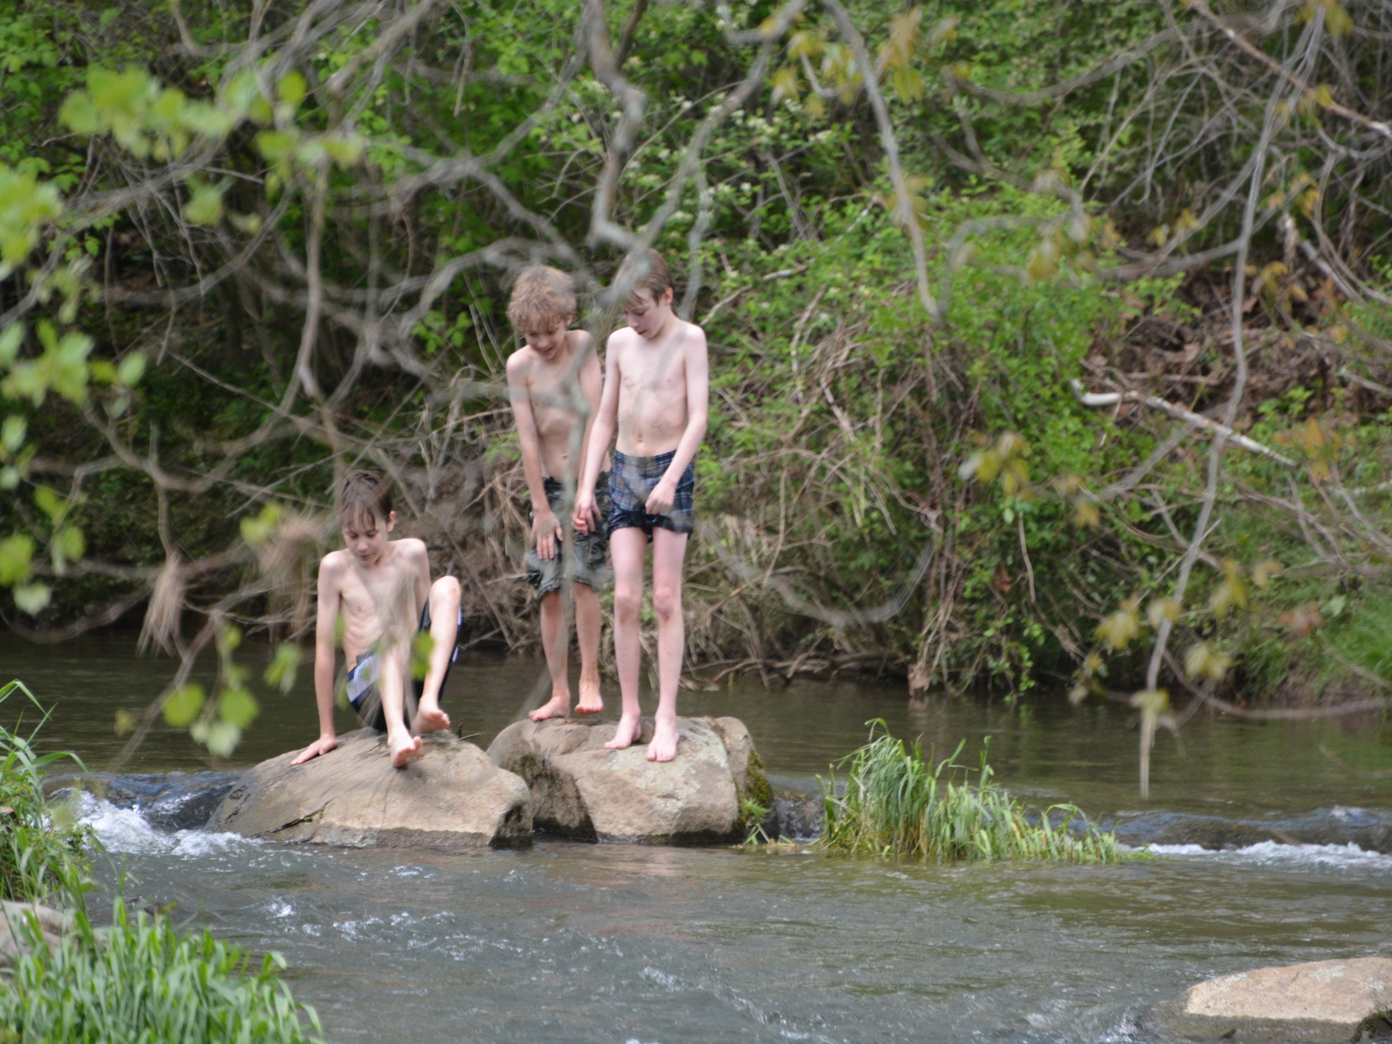

Conservation by Design 2.0
A Shared Conservation Agenda

Slide 2
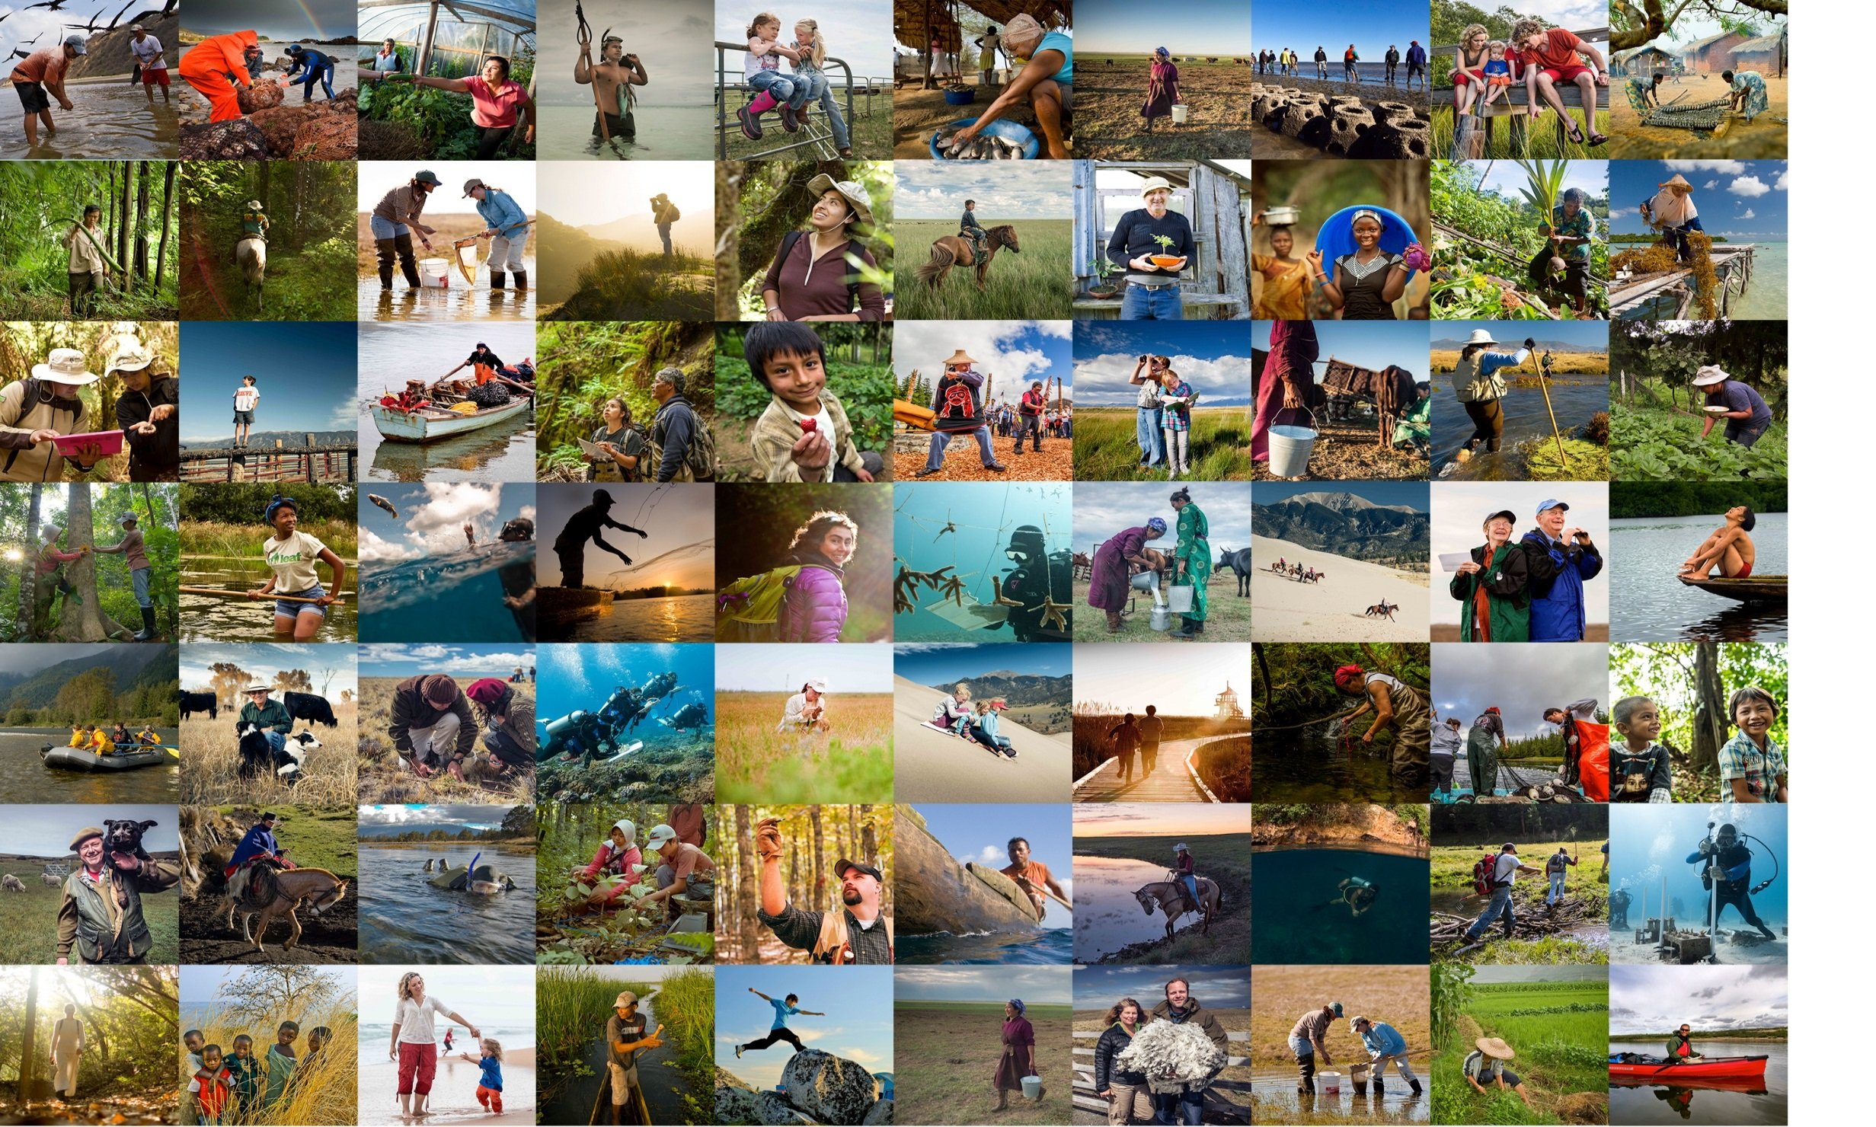
OUR MISSION
OUR MISSION:
Conserve the lands and waters on which all life depends

Slide 3
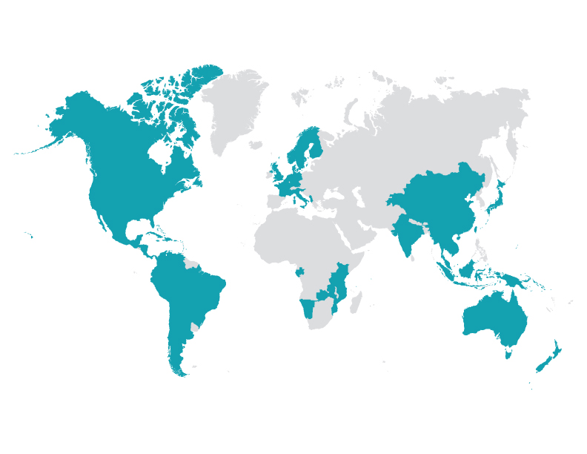
Global Reach:
Fifty States and 69 Countries

Slide 4
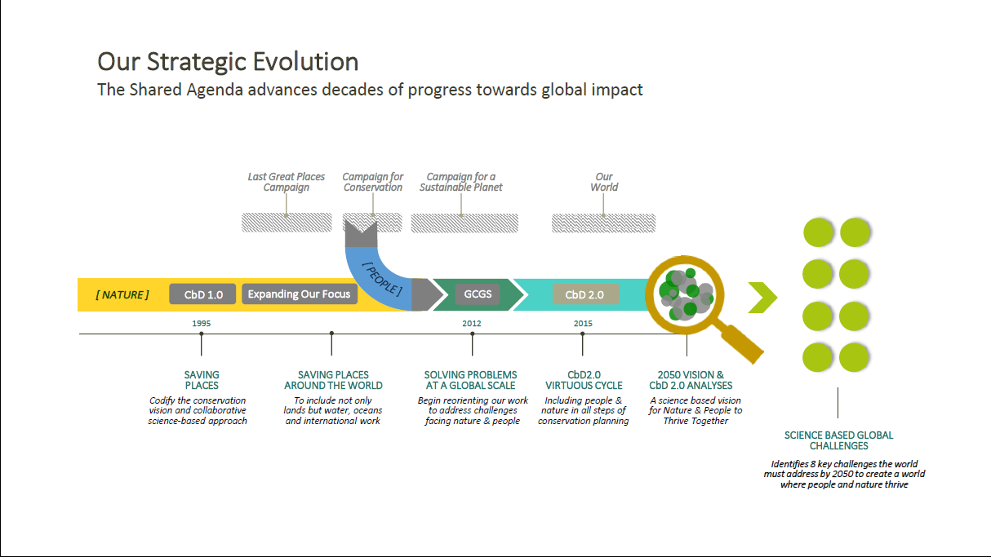

Slide 5
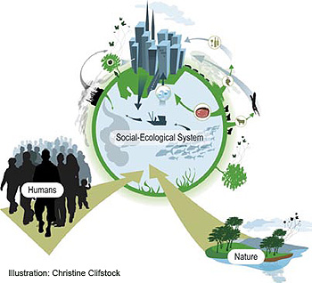
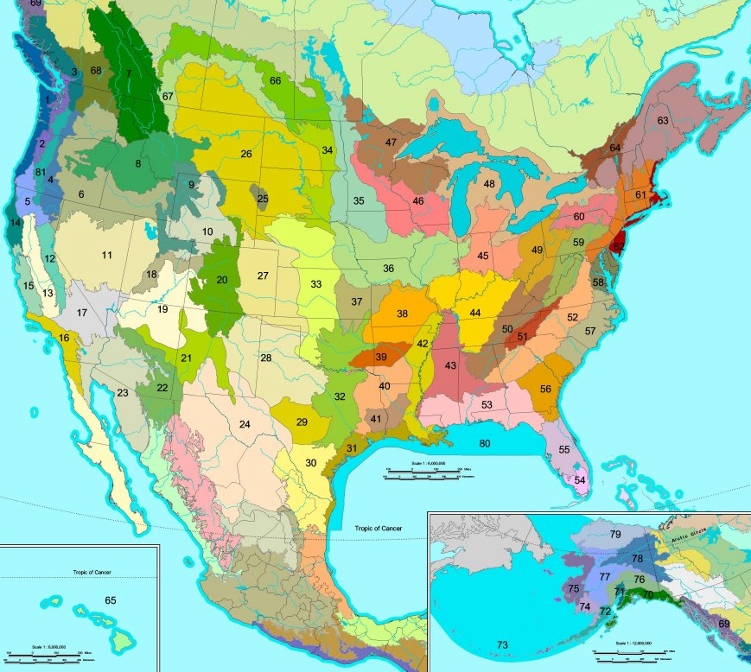
Conservation by Design - Organizational Focus
CbD 1.0
CbD 2.0
Nature
Nature & People
Ecoregions
Socio – Ecological Systems
Defined by Geography or Challenge
Globe – Region – Whole System

Slide 6
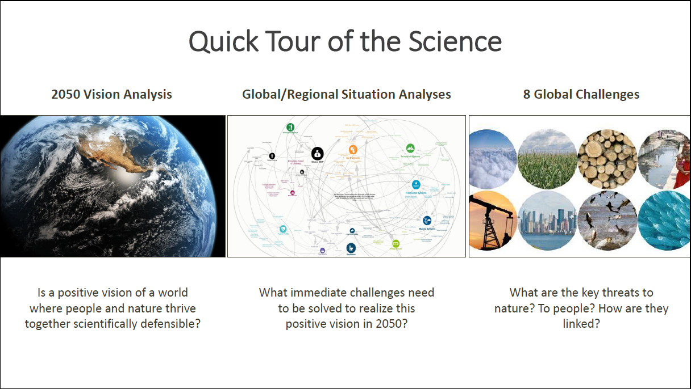

Slide 7
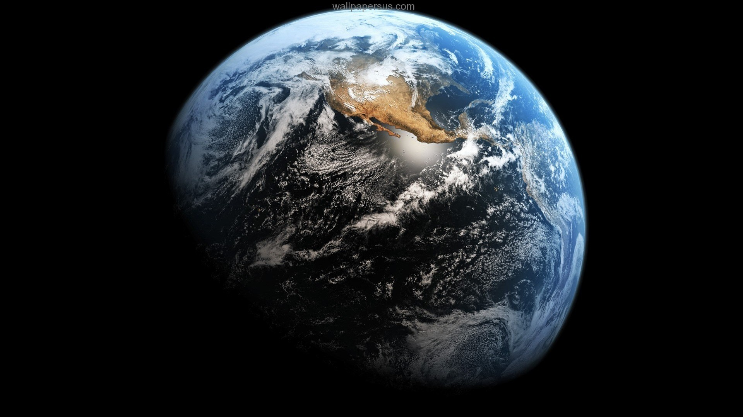
Realizing our global vision 2050
How can we achieve a world where nature and people thrive?
Notes:
People and nature face big challenges this century. As the population grows to 9 billion, how can we meet the food and energy demands that will be required to bring people out of poverty, without warming the climate, polluting the air with particulates, plowing up the forests and grasslands, overfishing the seas, draining our rivers for irrigation and polluting our waters with agricultural runoff. Clearly, if we don’t get this right, it will be bad for both nature and people.
We developed two scenarios, a ‘business as usual’ scenario and a ‘conservation’ scenario. These scenarios were developed as spatially explicit models for the entire globe, projected out to the year 2050. The scenarios included the impacts of agriculture, fisheries, energy production and human settlements on land and water use, GHG emissions, air pollution and nutrient pollution. In both scenarios, the human population grows, becomes wealthier, and demands more food and energy. These human demands on the system are the same in both scenarios. In the conservation scenario, energy production is increasingly from low-carbon sources and is fully mitigated, crop expansion is limited by increasing crop yields and shifts to more water-rich areas to prevent excessive water withdrawals from rivers, and fisheries are harvested sustainably.

Slide 8



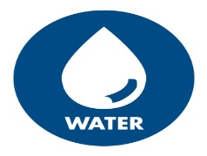
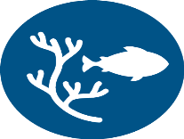


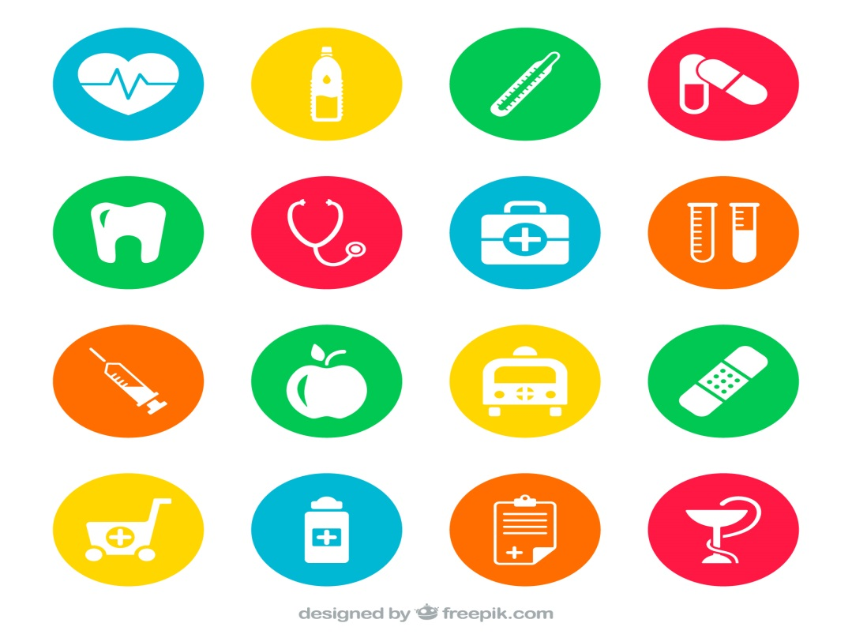
CbD 2.0 Multi – Scale Situation Analysis
Nature
Nature - People Linkages
People
1. Challenges to nature?
Lands
Food Security
2. Challenges to people?
Freshwater
3. Which are connected & how?
Water Security
4. Evidence for strongest connections?
Oceans
Energy Security
What patterns hold & what changes:
From global - to regional - to whole system?
Climate
Human Health
Notes:
I’ve mentioned situation analysis multiple times now as part of our new approach, so let’s spend a few minutes – at a high level – on it. Conceptually, our application of the situation analysis tool for our work is pretty straight-forward. The purpose is to identify the key challenges affecting nature and people within a geography or a situation analysis can have a thematic focus, such as food supply chain. This tool can be applied at any scale – from the world, to regions to whole systems and we ask 4 fundamental questions in a situation analysis. The first 2 are asked independently: what are the challenges facing nature and what are the challenges facing people? Once we have these answers we ask, which of those problems are connected, and how? Having this answer makes it clear the challenges facing nature alone versus those that are also being faced by people. Finally, we ask, what is the evidence for the strongest connections? By answering these questions in a systematic way, and understanding the strength of evidence for the answers, we generate a science-based assessment of the most significant challenges facing nature, and those challenges impacting both people and nature. Applying this systematic approach of a situation analysis first at the global level and then stepping it down to finer scales enables us to understand how these challenges hold and change at finer scales. One could imagine the patterns changing from the globe, to North America, to the Gulf of Mexico for example. Knowing this helps us understand organizationally what we work on together and what aspects of our work are unique to our particular area.
Since I mentioned situation analysis is used to set priorities, I suspect some of you are wondering about the implications of CbD 2.0 for current priorities. The intent is to use our updated conservation approach to adjust current priorities through time, there is not intent to ‘clean slate’ current priority work and reassess it all. Instead we will use CbD 2.0 to adjust current work and inform new priorities.

Slide 9
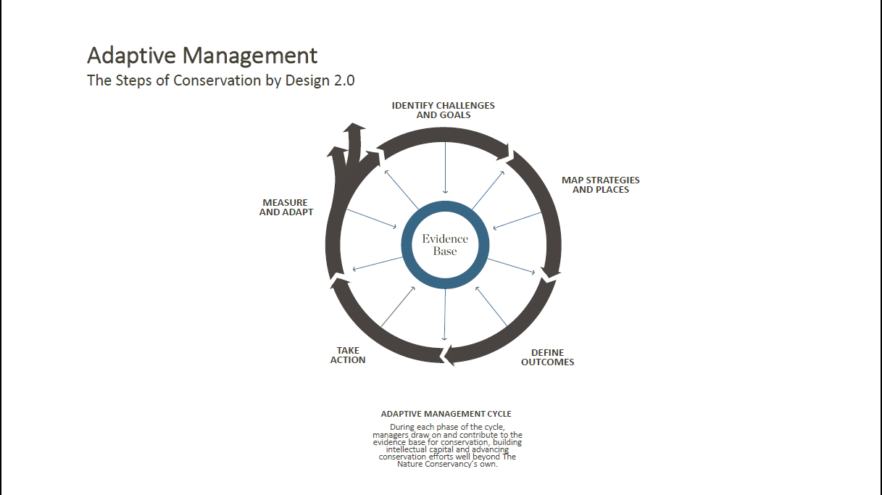

Slide 12
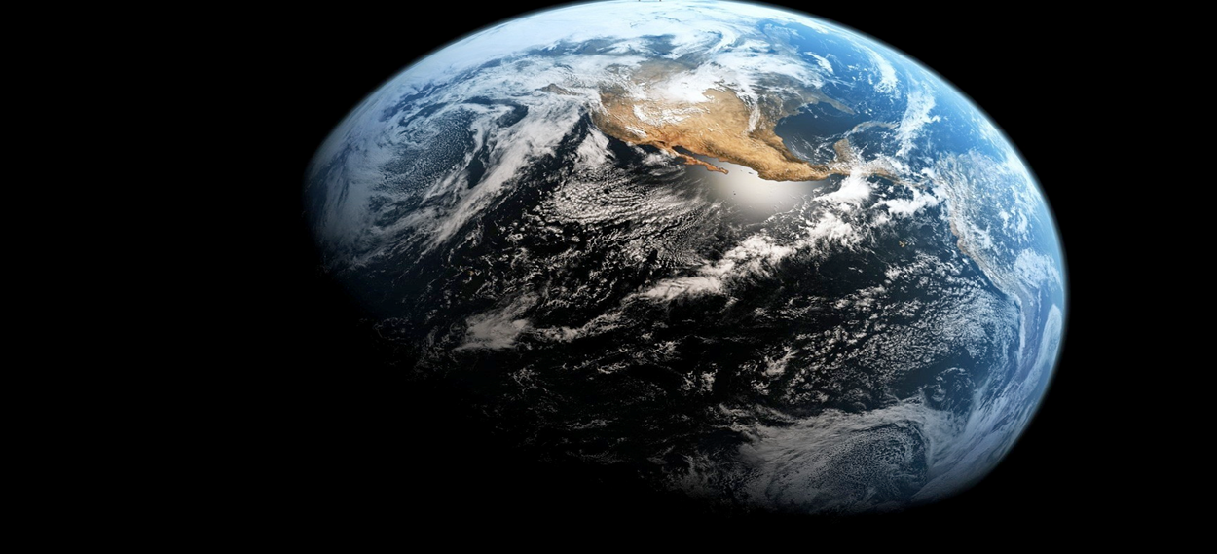
TNC Global Vision
We envision a world where the diversity of life thrives, and people act to conserve nature for its own sake and its ability to fulfill our needs and enrich our lives.
Notes:
In the Overview of CbD 2.0, which was approved by Board of Directors in February of 2015, we confirm that TNC stands for nature- in all of its diversity and functions; from the intrinsic value of nature to the variety of services it provides to people. We also recognize that choosing between people and nature is a false choice, that people and nature are inextricably linked; this acknowledgment has implications for how we set priorities and the strategies we pursue to achieve the mission.

Slide 13
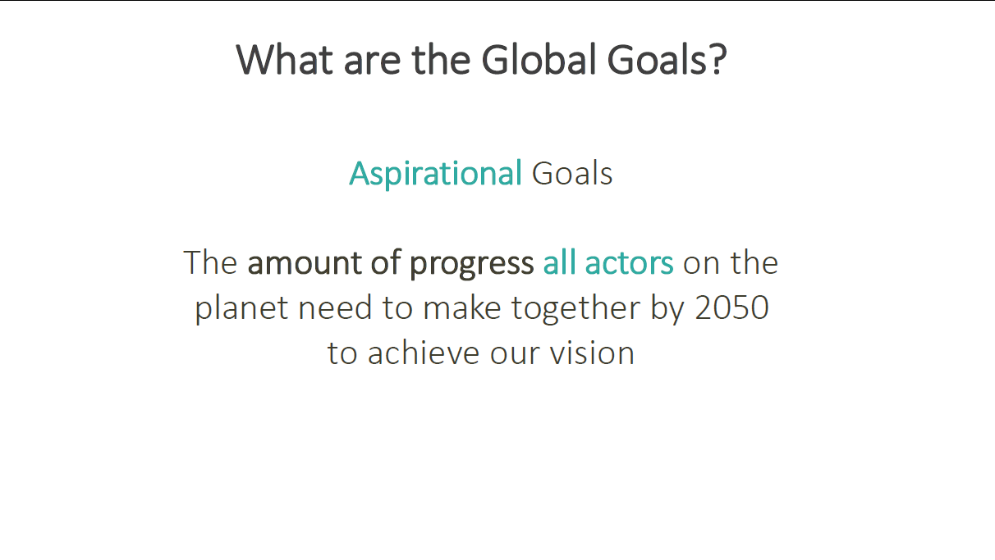

Slide 14
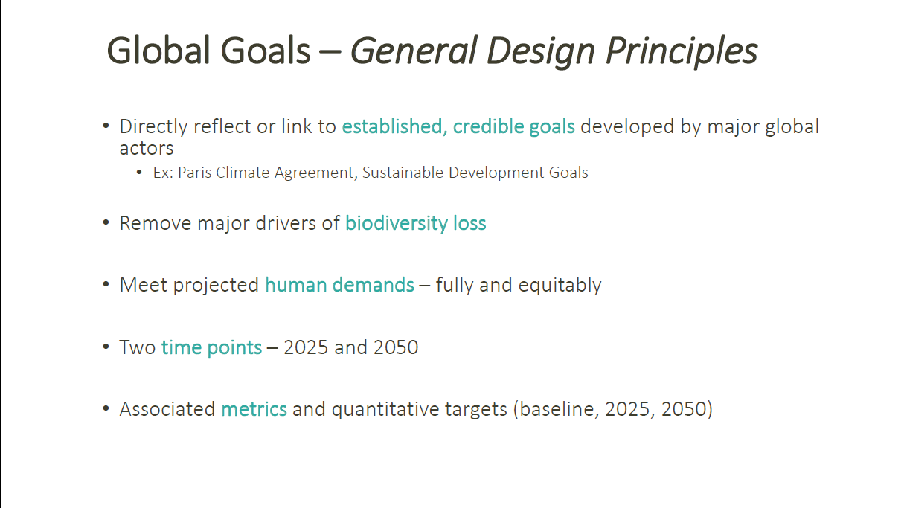

Slide 16
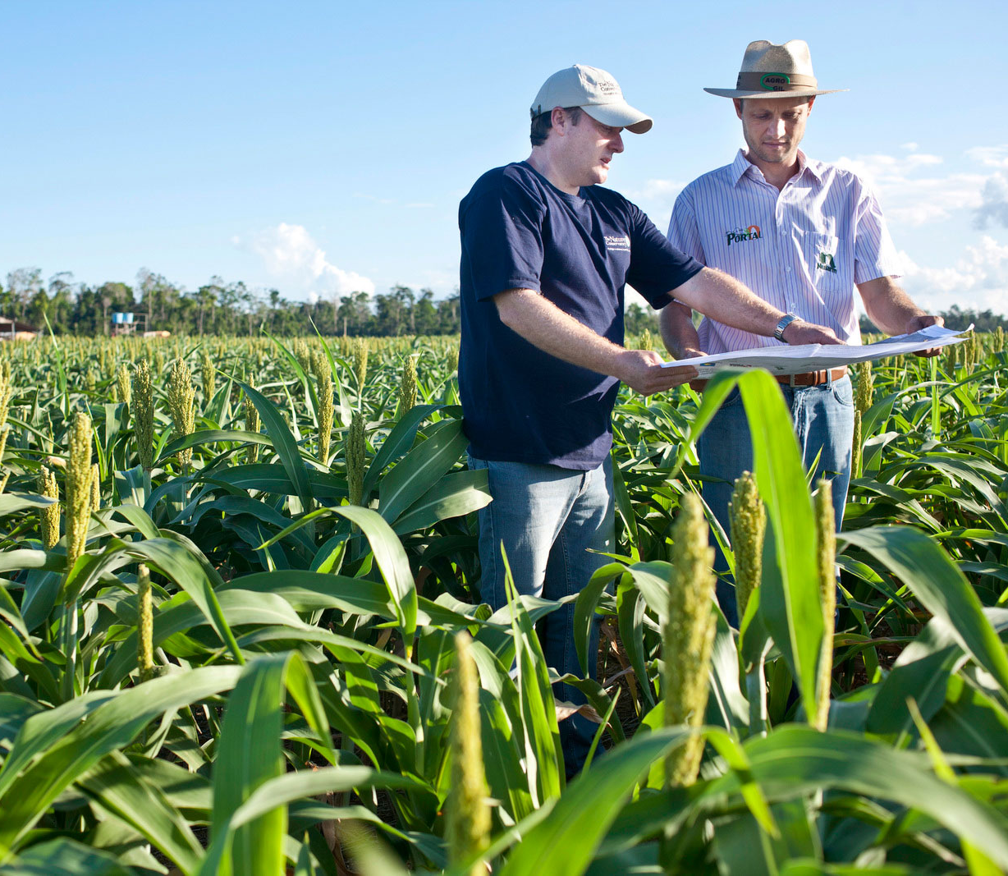
What is a Priority?
TNC is uniquely positioned to make a material contribution to solving Global Challenges
a strategy or collection of strategies
contributes to at least one TNC Outcome and one Global Challenge
management decision informed by science
Resources: Shared Conservation Agenda CONNECT site
Notes:
Priorities are what we will focus on to achieve TNC Outcomes. They characterize HOW we work to solve the Global Challenges – and will be where we’ll focus our energies going forward.
Priorities are a strategy or a collection of collection of strategies that contribute to at least one TNC Outcome. Each priority contributes to one or more Global Challenges.
The way we achieve that material contribution to a Global Challenge and TNC Outcomes can be described as our Theory of Transformational Change. Lynn Scarlett is leading our work on the TOTC, which you’ll hear more about at the Senior Leaders Meeting. Simply put, the TOTC aims to identify how a strategy or collection of strategies will work synergistically to make a material contribution to a TNC Outcome and a Global Challenge
Since we have a body of work currently underway, the ET and CMT considered how our existing body of work contributes to the Global Challenges; asking where TNC can make a material and unique contribution. The resulting priorities provide focus for the organization that is informed by science.

Slide 17
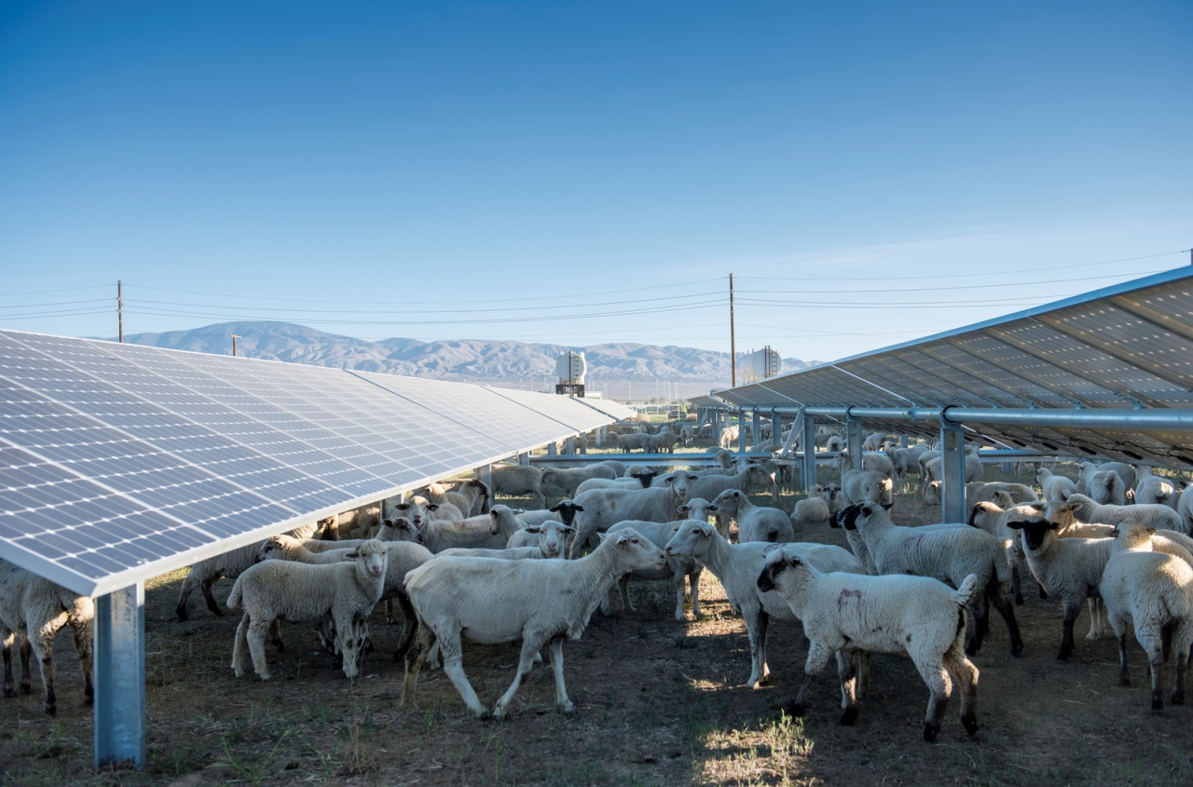
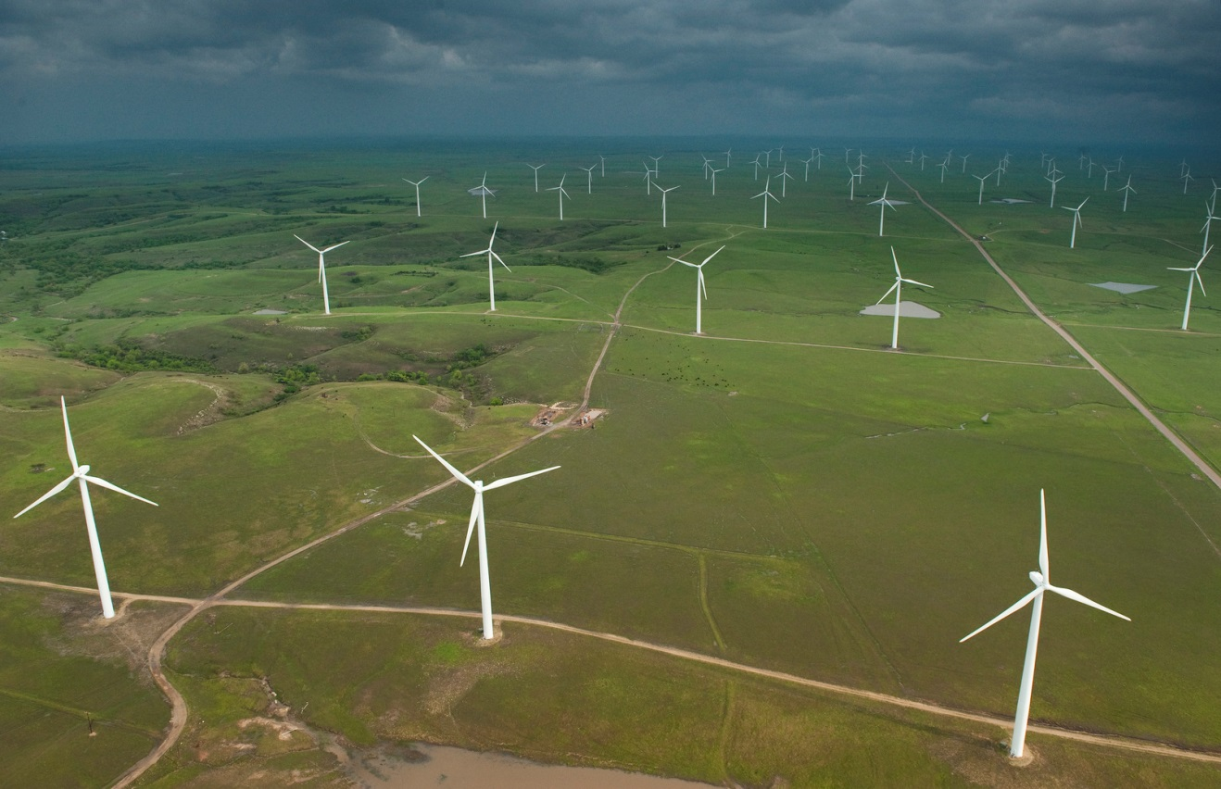
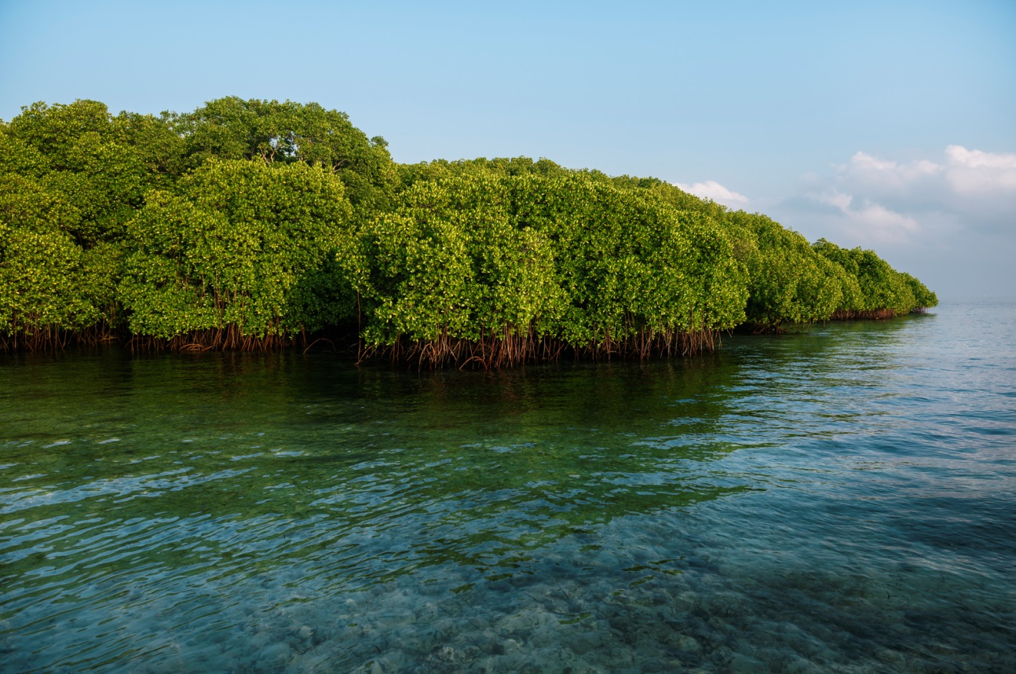
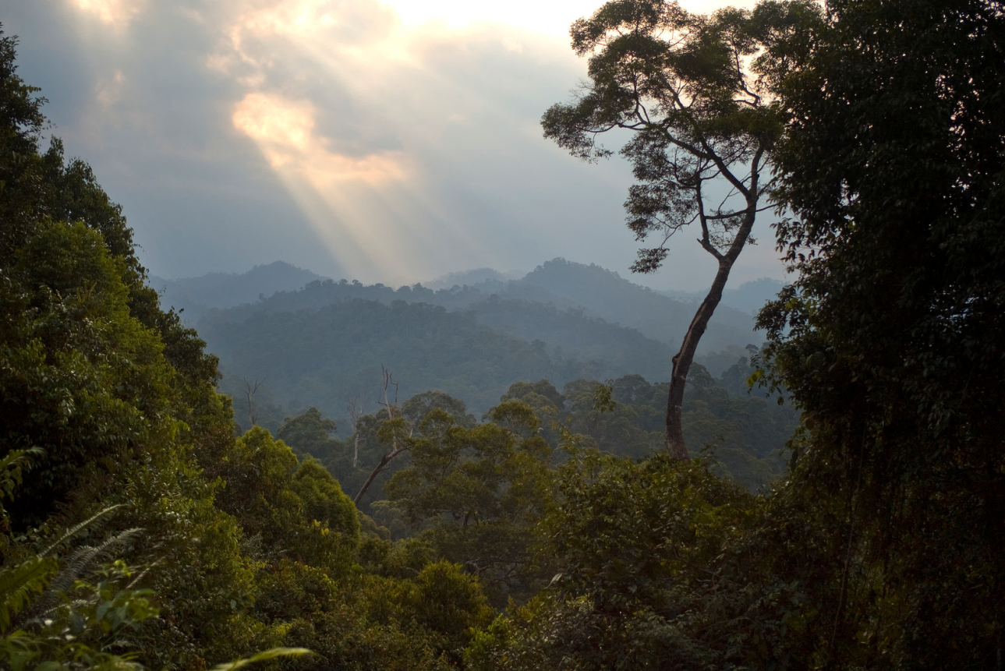
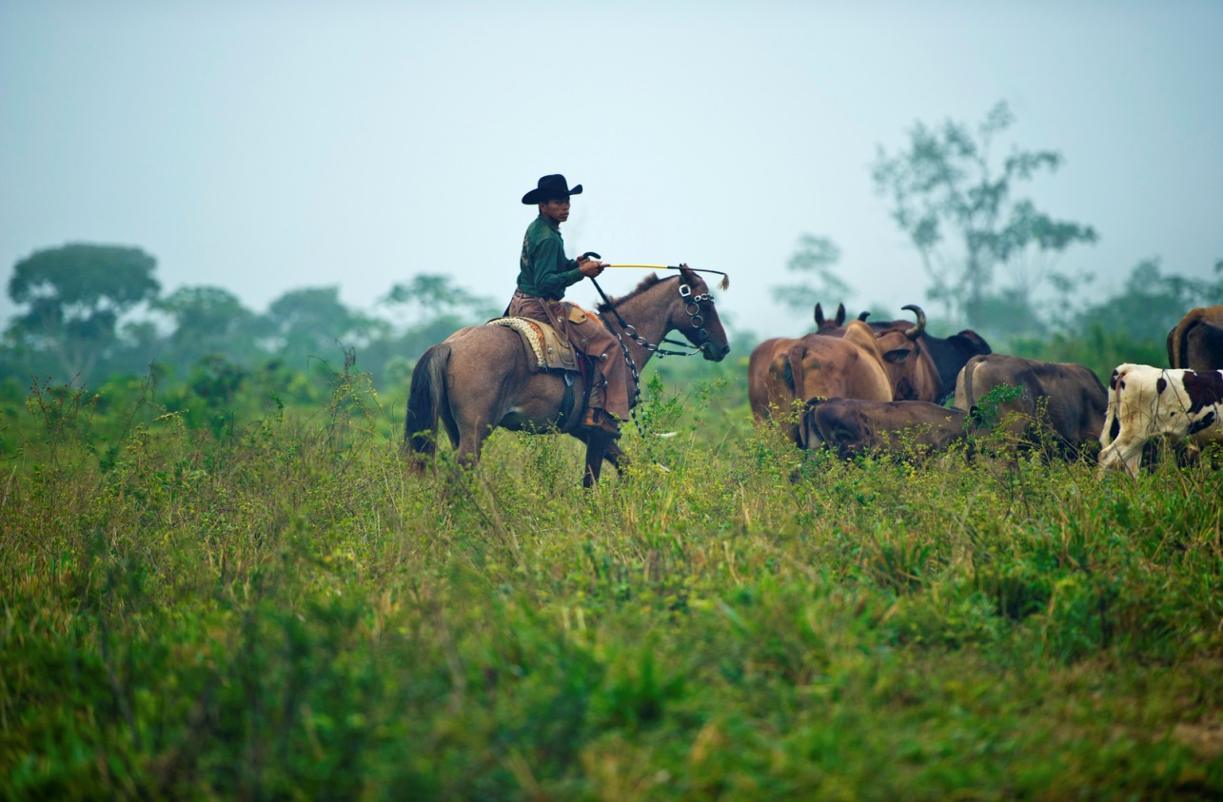
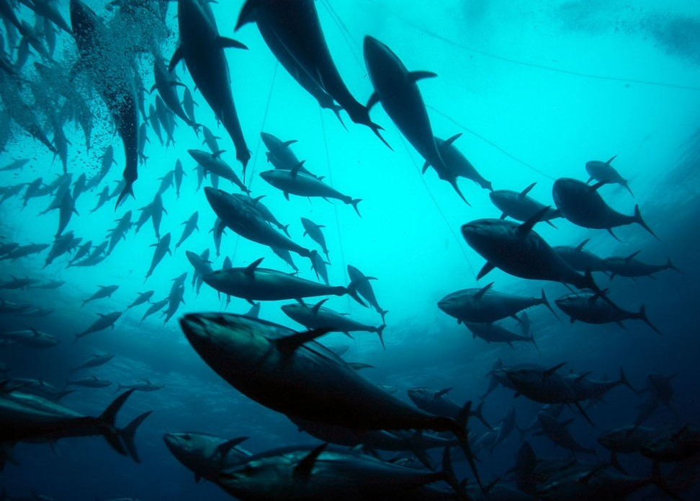
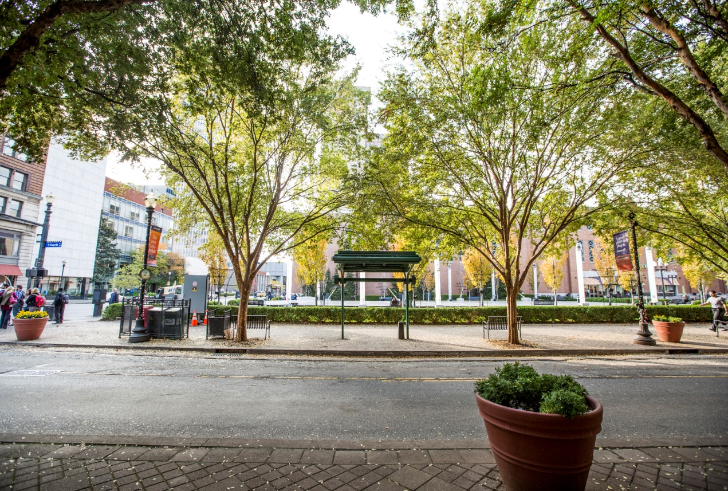
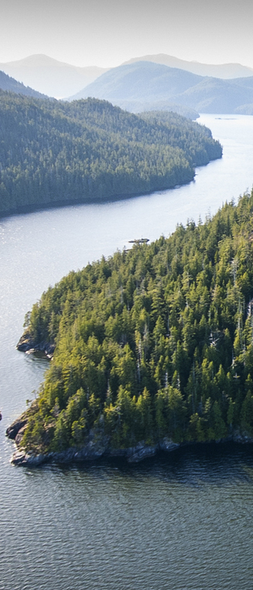
TNC Proposed Priorities
Low Carbon Future
Mitigate Energy Sprawl
Climate Adaptation
Natural
Climate
Solutions
Sustainable Agricultural Practices
Sustainable Fisheries Management
Green Urban Future
Protecting the Wild
Notes:
CLIMATE
Low Carbon Future - Change energy policy to accelerate our transition to a clean energy future
May 2014. Sheep used for weed and grass management grazing at the Fuller Star solar project in Lancaster, California. Photo credit: © Dave Lauridsen for The Nature Conservancy
Climate Adaptation - Share solutions that generate sustainable power and conserve biodiversity
July 2015 In route to visit mangroves on Lembongan Island. Approximately 30 miles from Bali. Mangrove forests are “fish factories” that support fishing jobs and food security. The Conservancy is ramping up their efforts to strengthen the resilience of coastal communities as storms increase and sea levels rise. Photo credit: © Kevin Arnold
Natural Climate Solution - Invest in nature to prevent catastrophic warming
The dense tropical Wehea forest in the Kalimantan region of Borneo, Indonesia. The Nature Conservancy is working with industry, partner organizatioins, national and local governments and communities to stop the destruction of the rain forest with a goal to protect 250,000 square kilometers (about 90,000 square miles) of forest in Kalimantan. PHOTO CREDIT: Bridget Besaw
FOOD
Sustainable Agricultural Practices - Encourage more productive agricultural activities to meet the growing demand for food and ensure nature continues to thrive
Joao Batista Dos Santos Fortado herds cattle on the Ponderosa farm in Paragominas-Pará, a municipality in the Brazilian Amazon. Understanding that conversion to agriculture and cattle ranching is the greatest threat to the Amazon rainforest, the Conservancy works in strategic municipalities of the Brazilian Amazon – such as Paragominas – to implement strategies to control deforestation and promote the responsible production of soy and beef among farmers and ranchers. Photo credit: © Ami Vitale

Slide 18
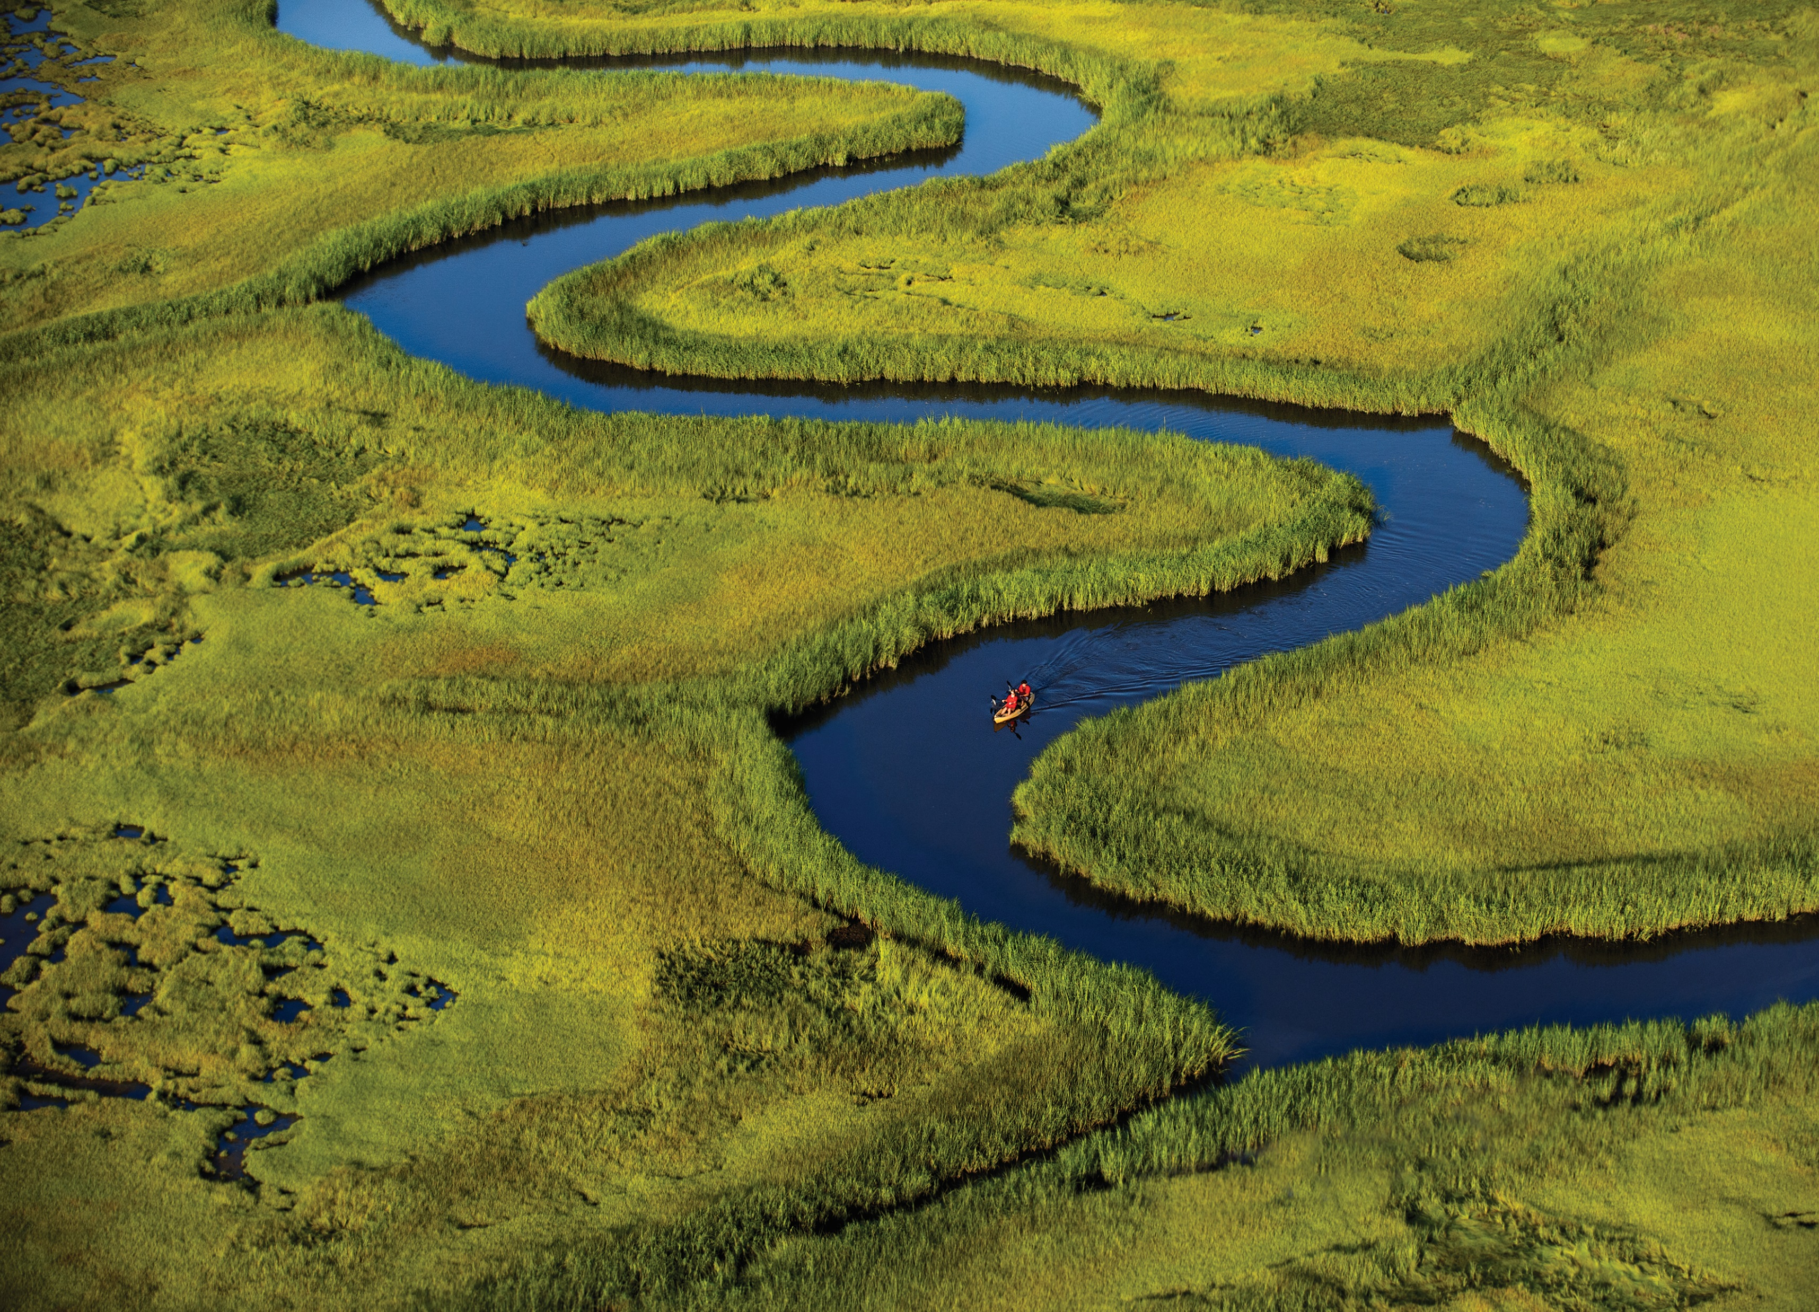
Land Protection
At a Scale and Place That Matters
Bayshore Forever

Slide 19
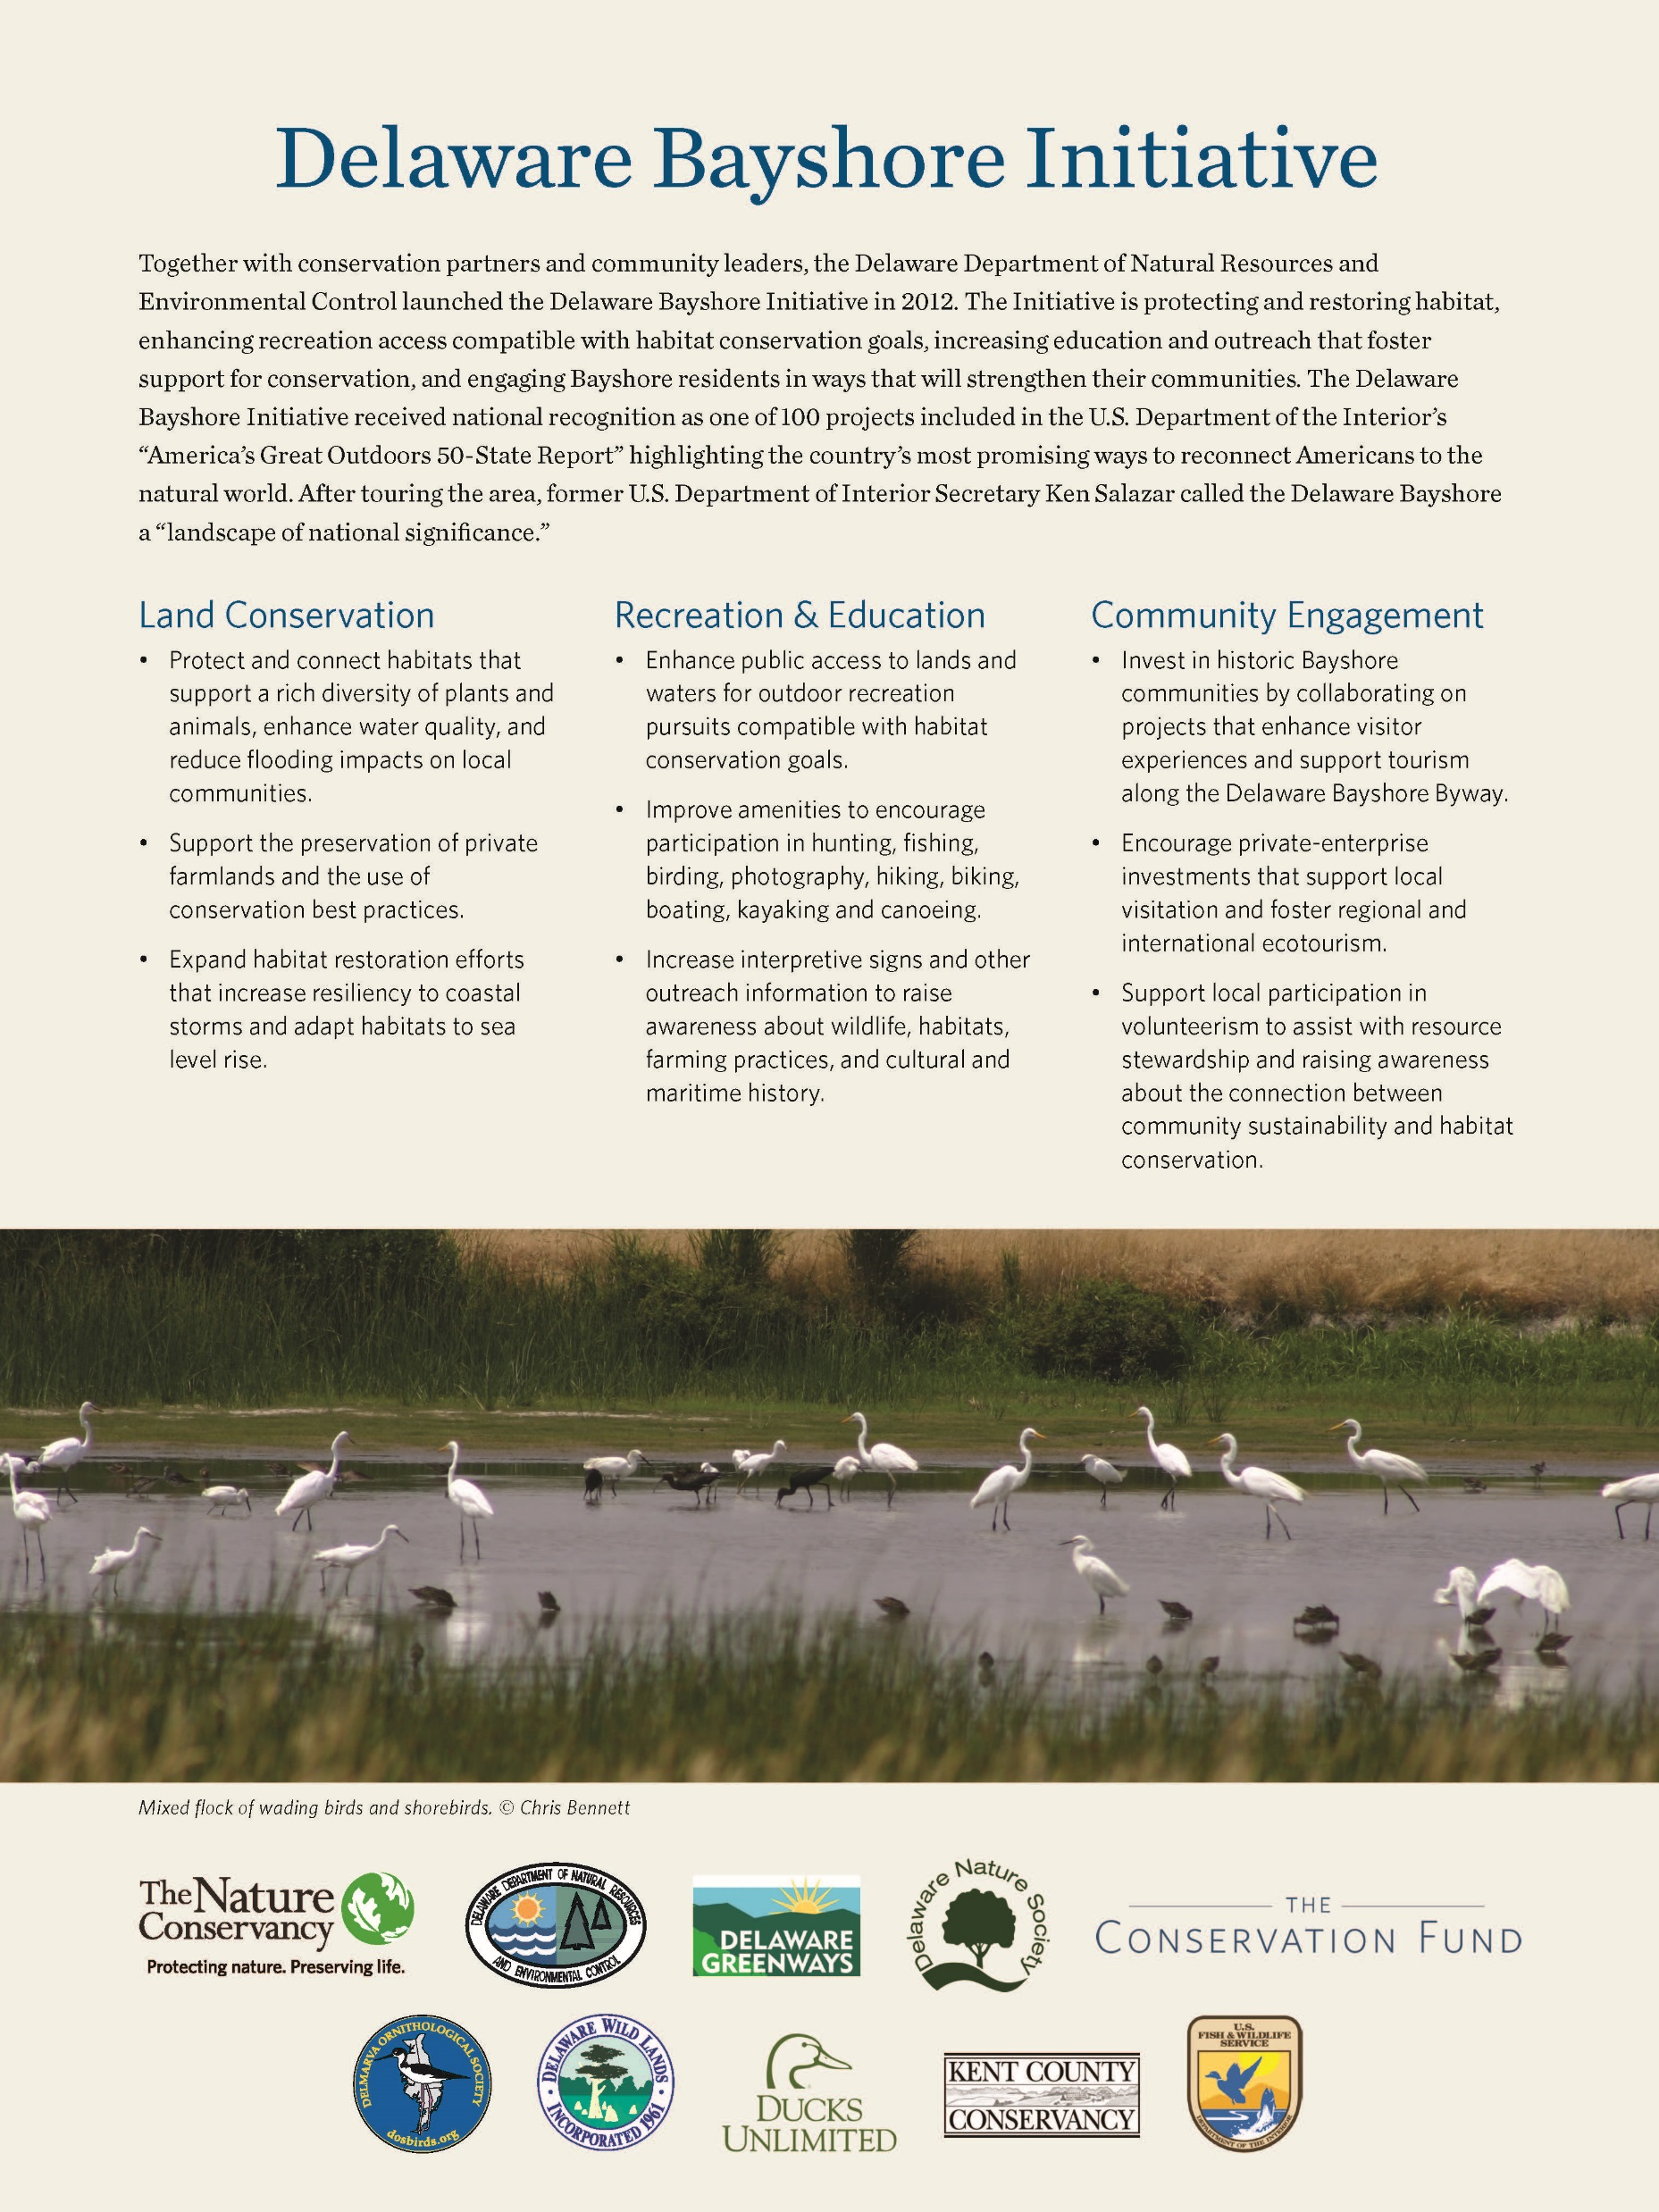
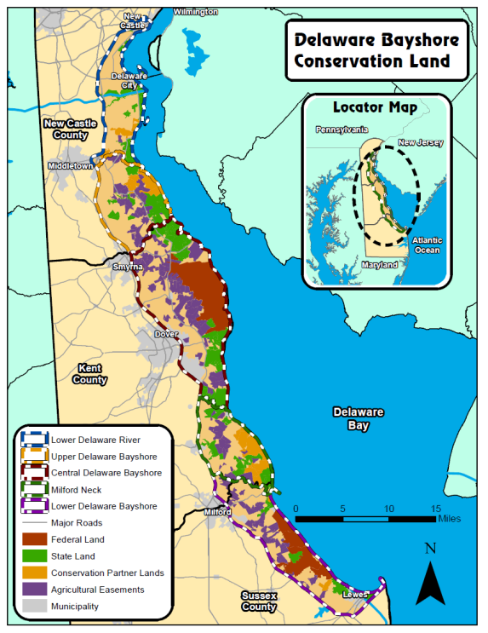

Slide 20
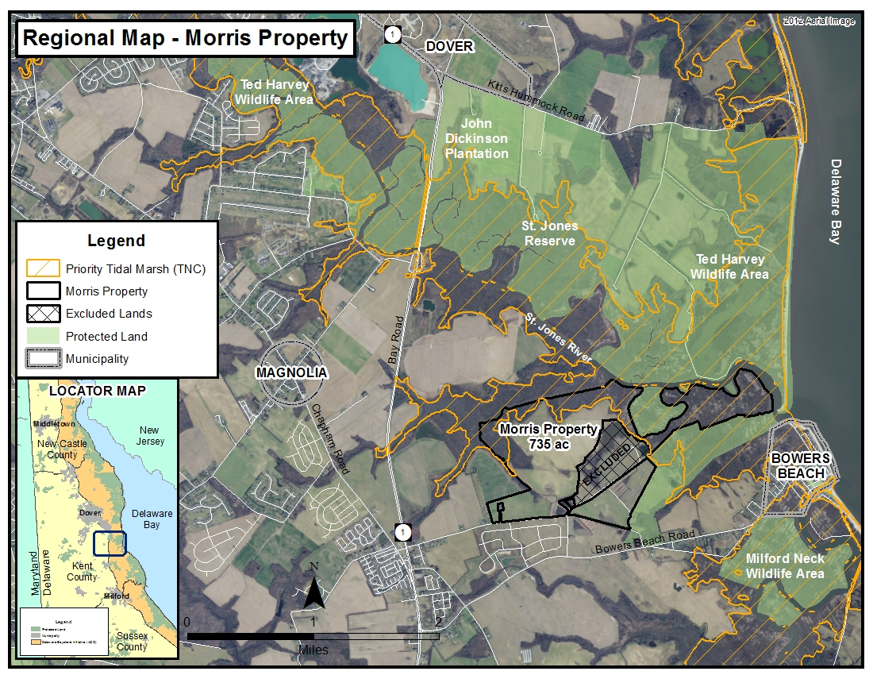

Slide 21
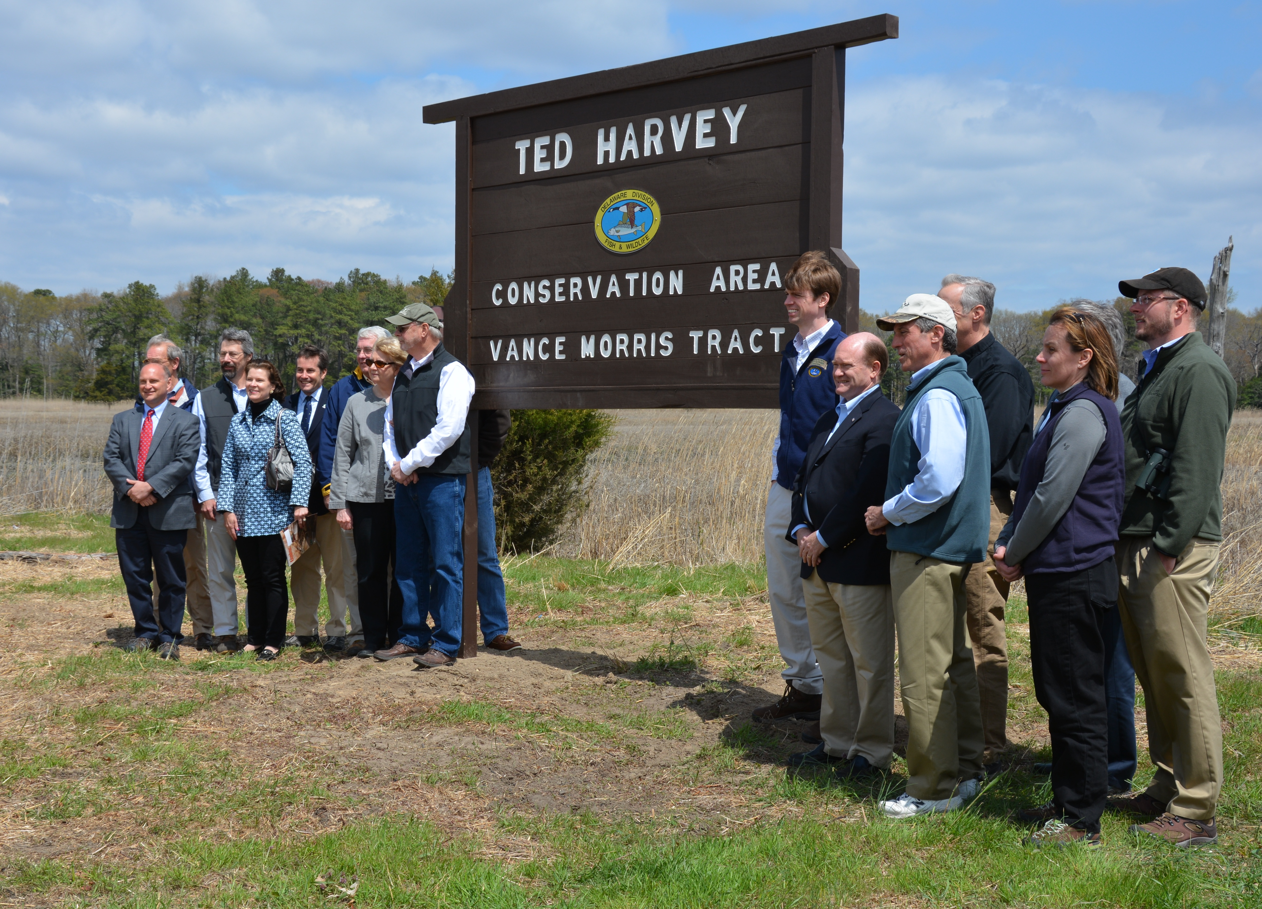

Slide 22
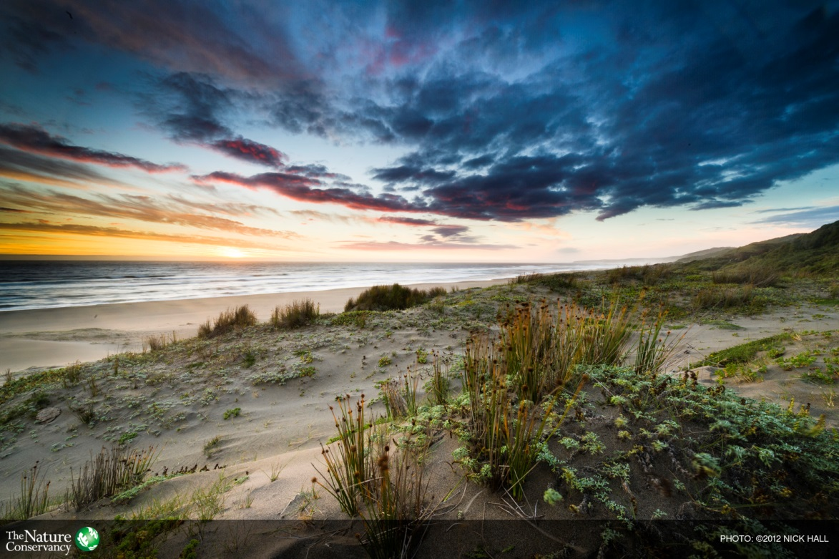
Climate Adaptation
Coastal Resilience
Milford Neck Hydrologic Restoration

Slide 23
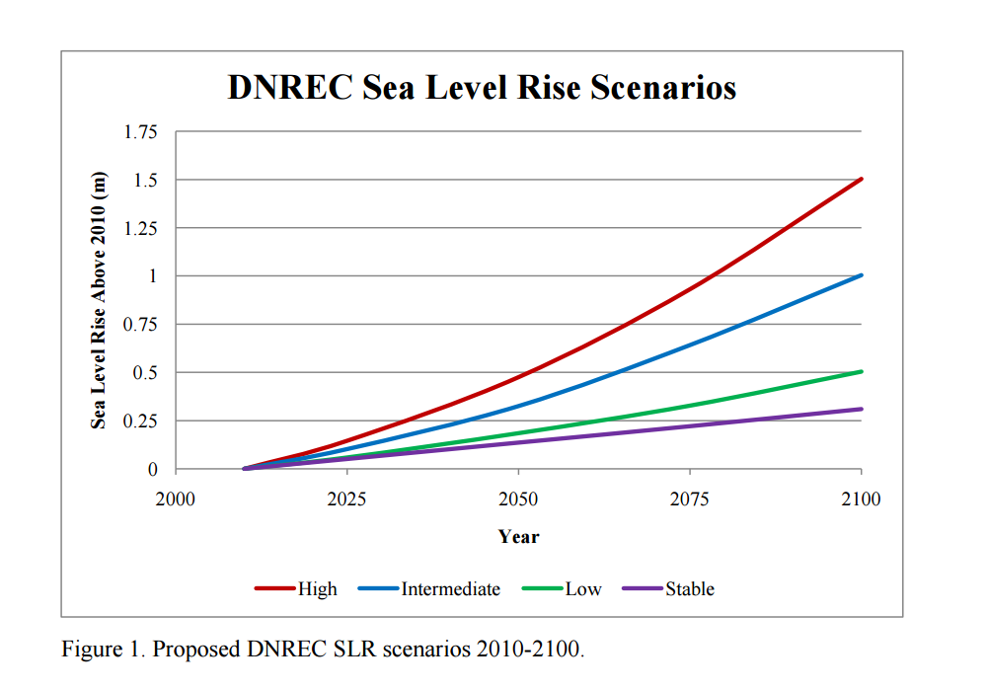

Slide 24
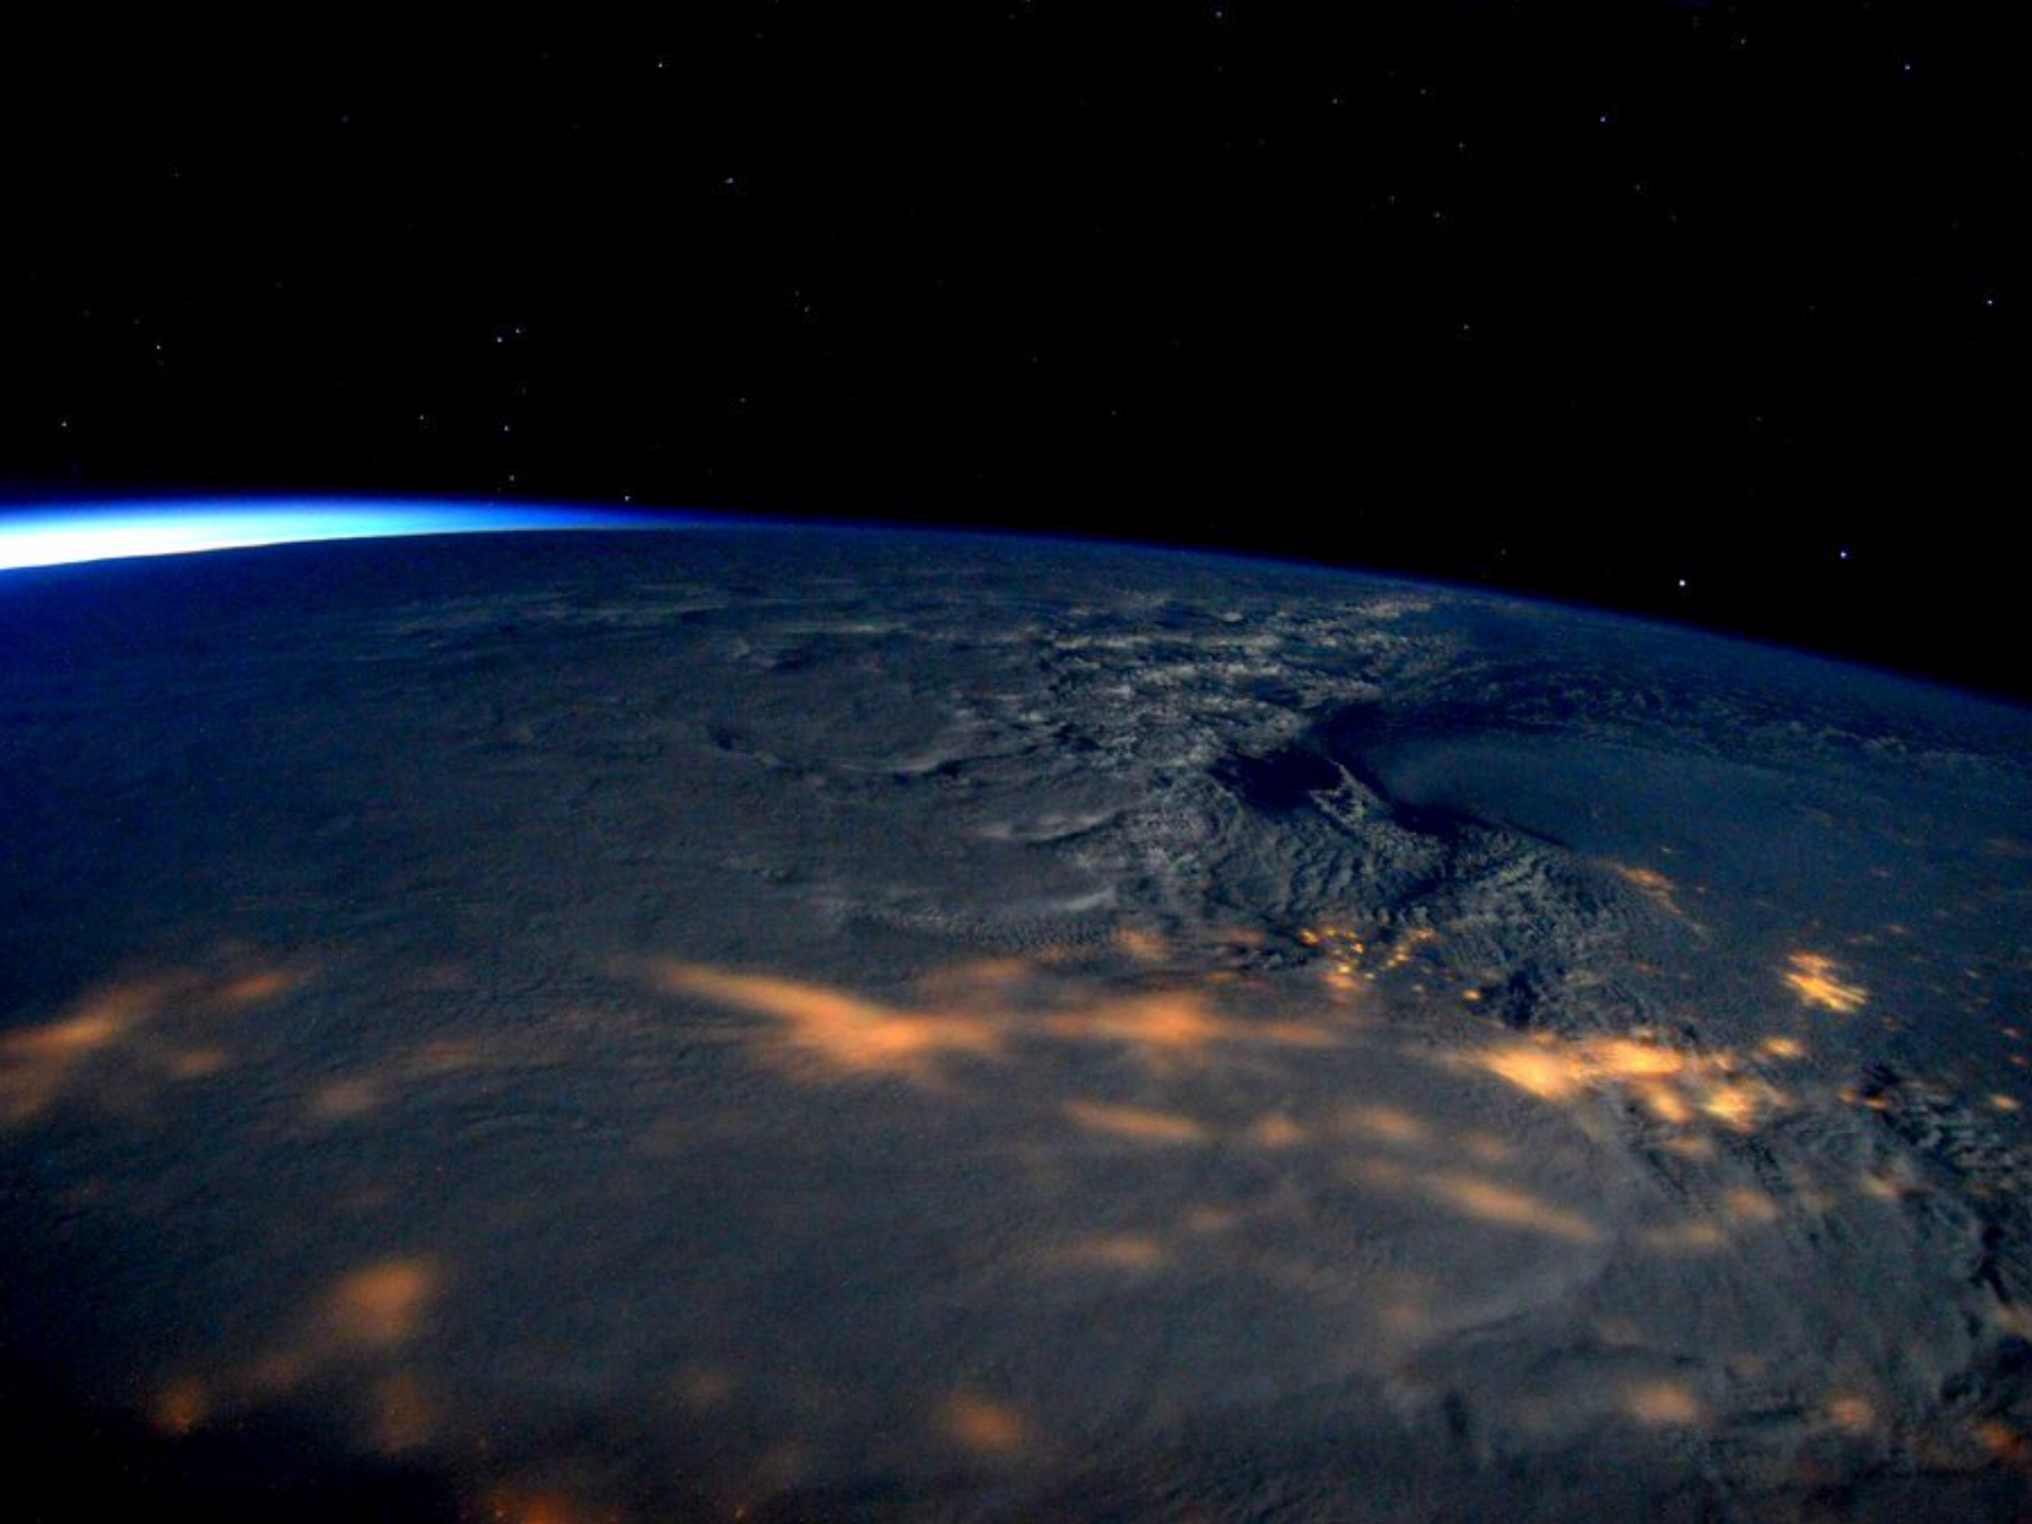

Slide 25
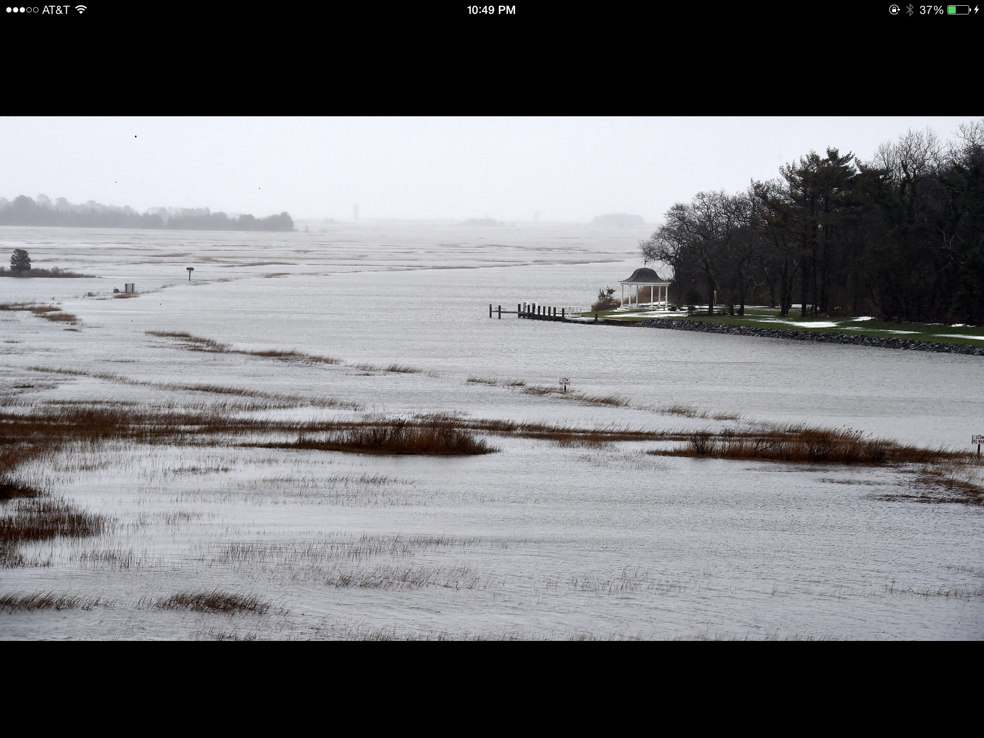

Slide 26
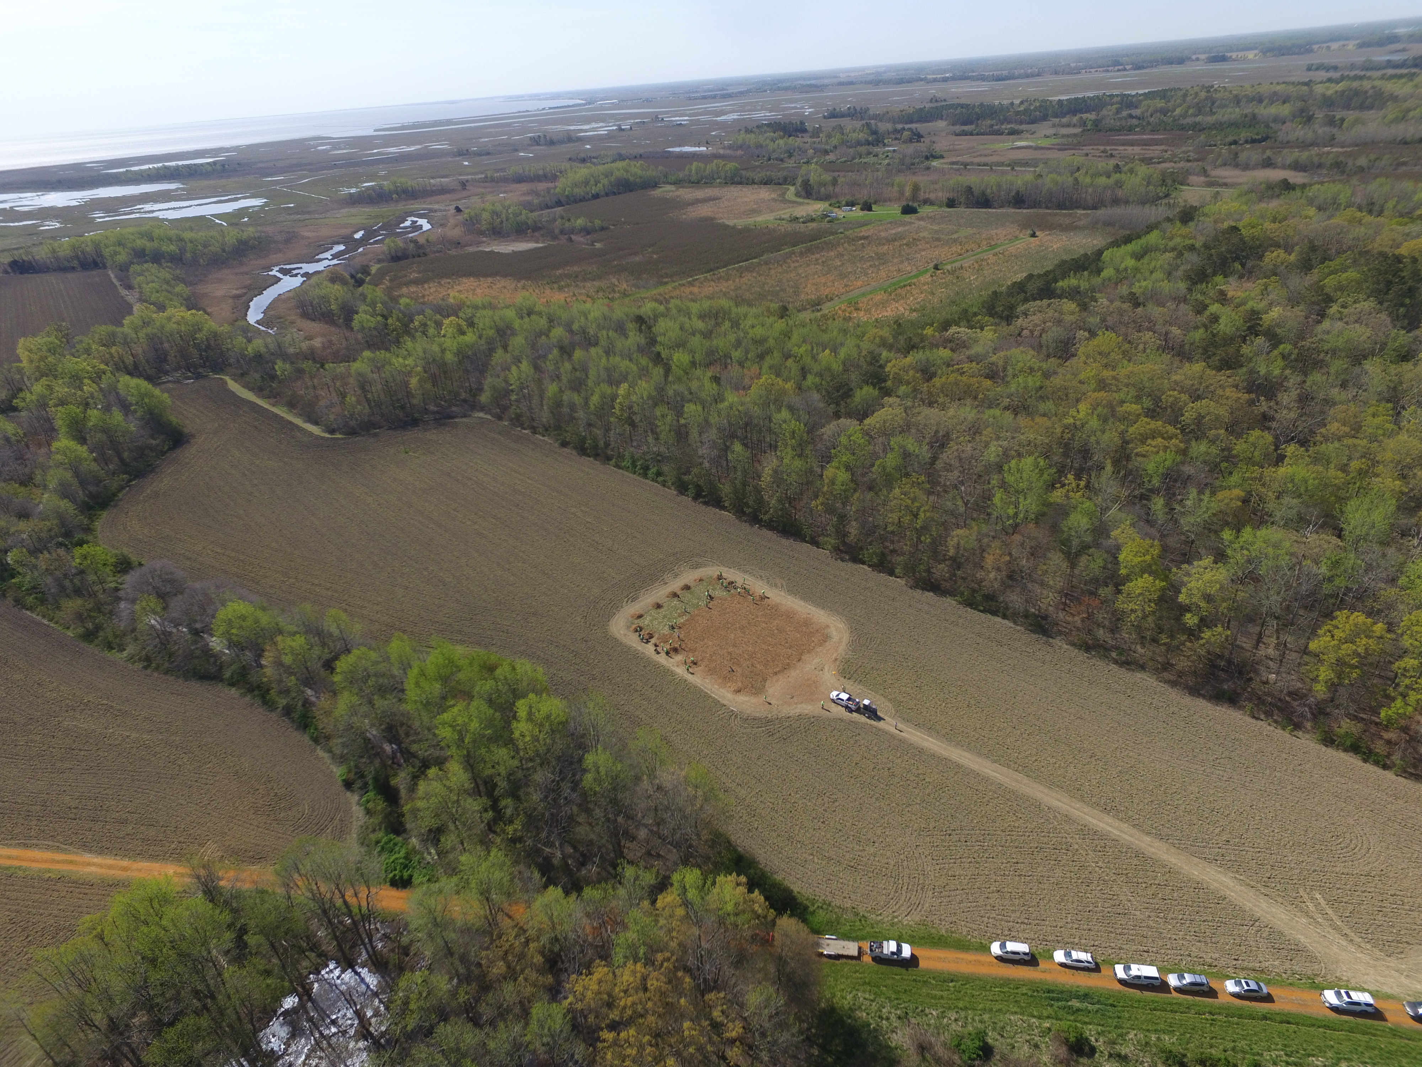

Slide 27
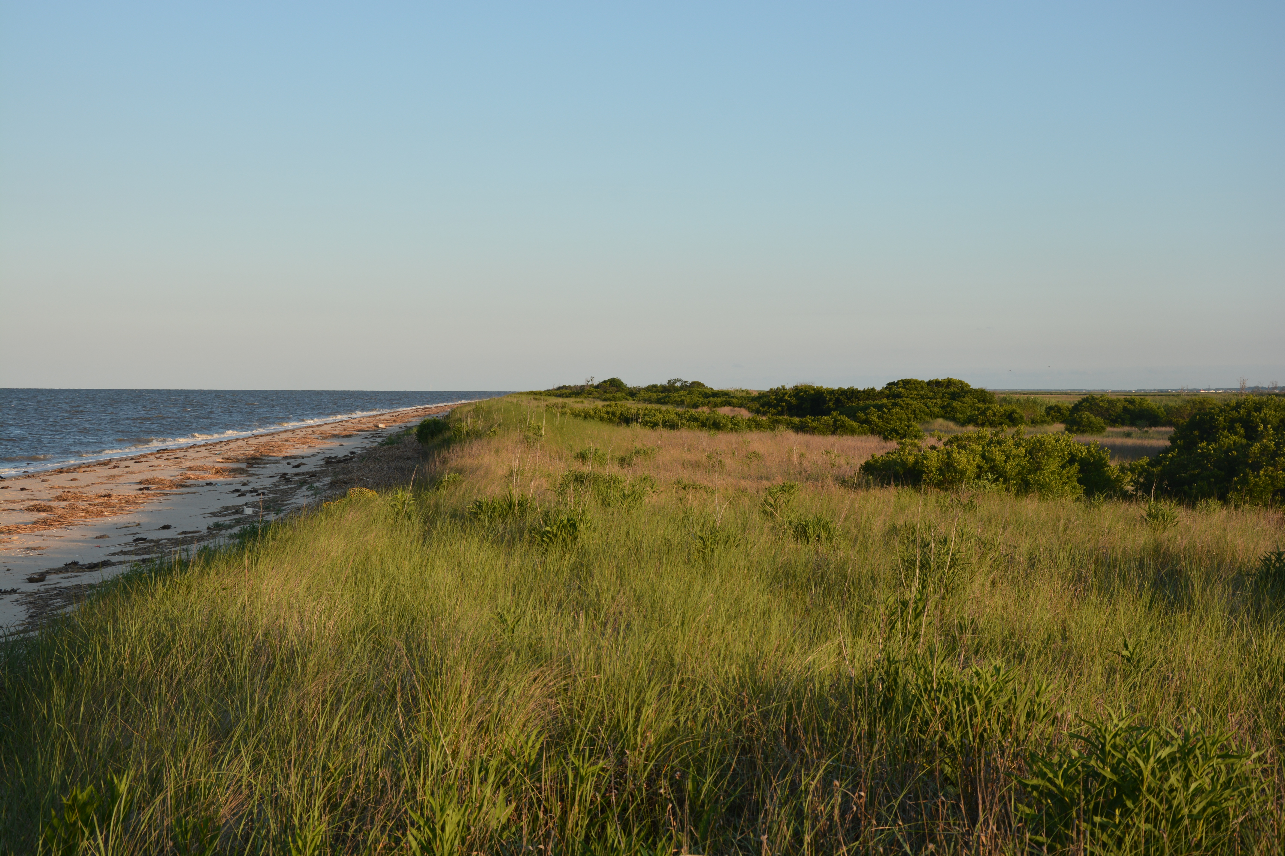

Slide 28

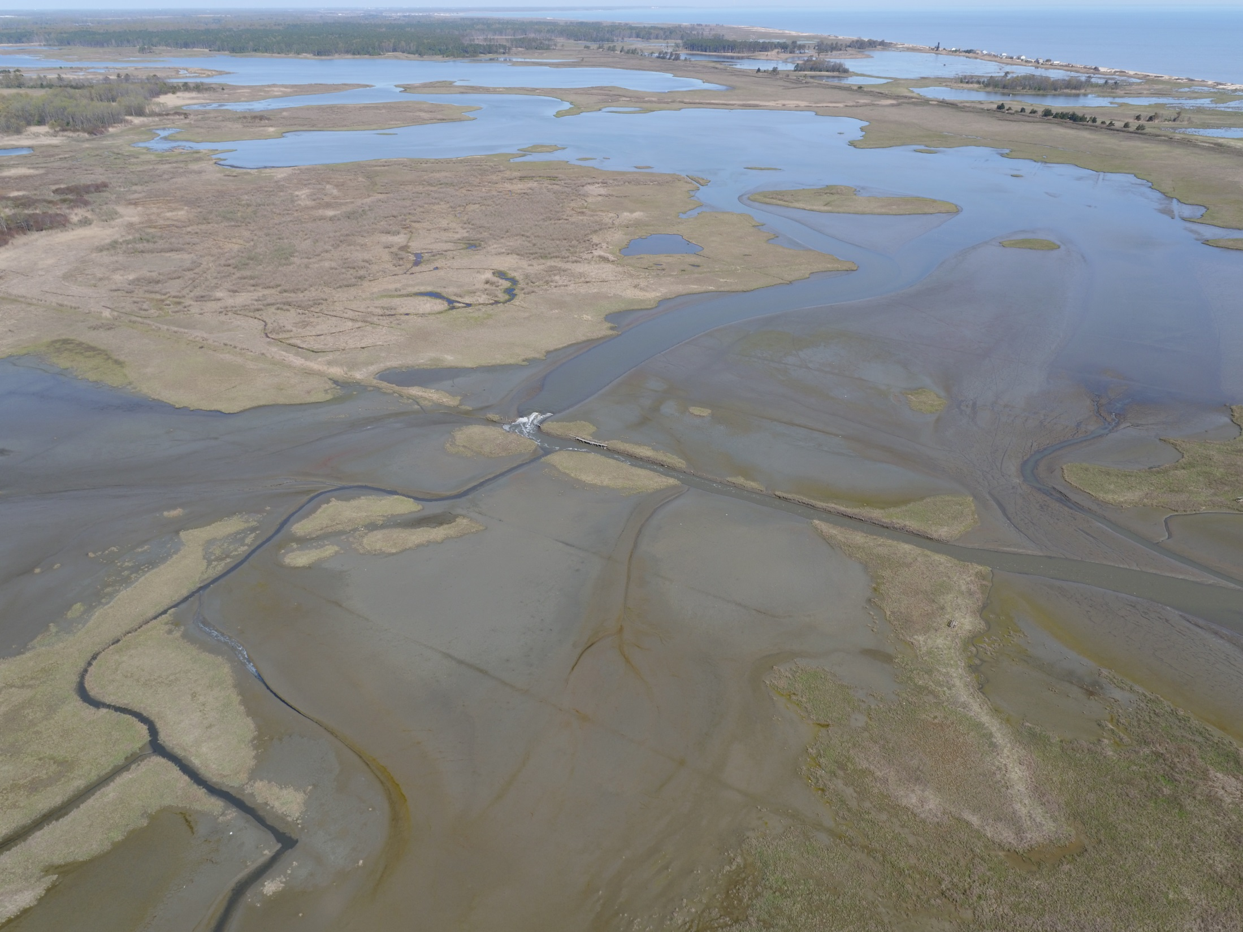
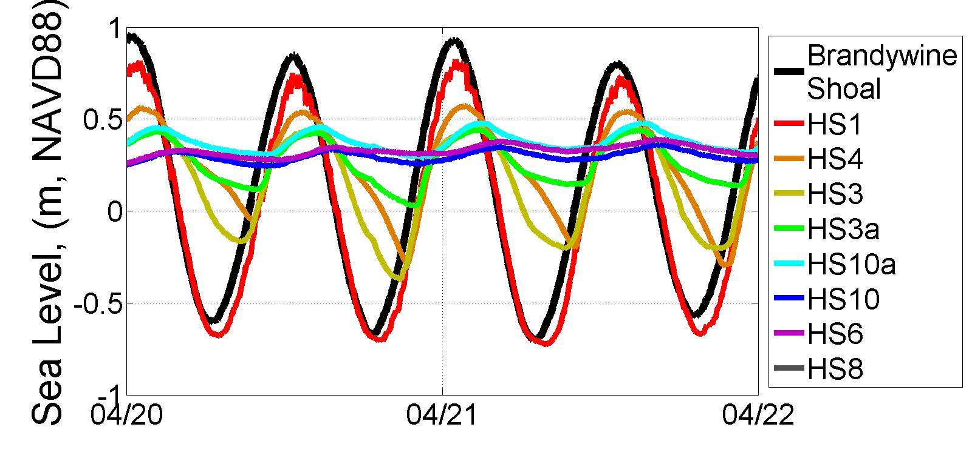
Deployment 2 Data:
HS10
HS10a
HS3a
HS3

Slide 29
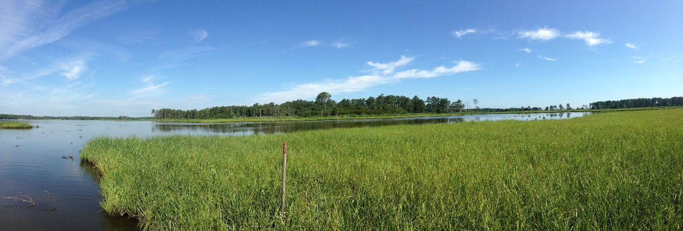
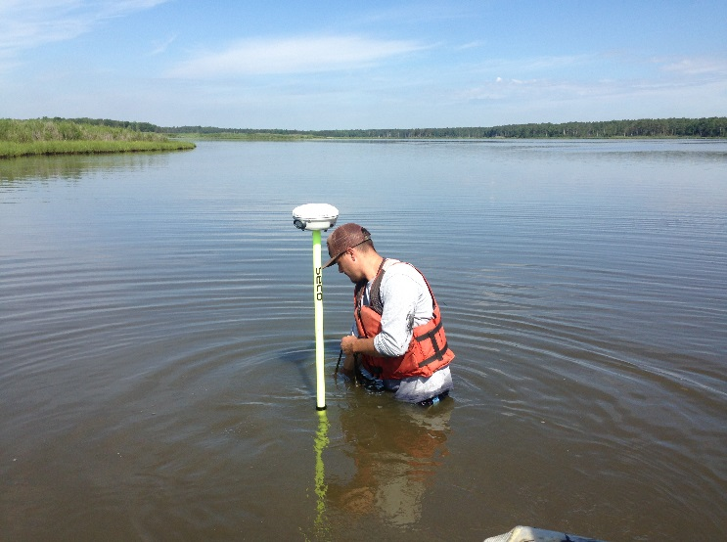
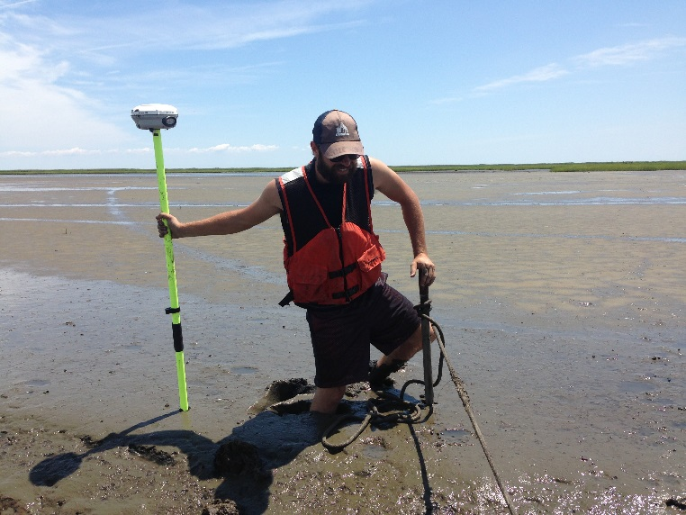

Slide 30
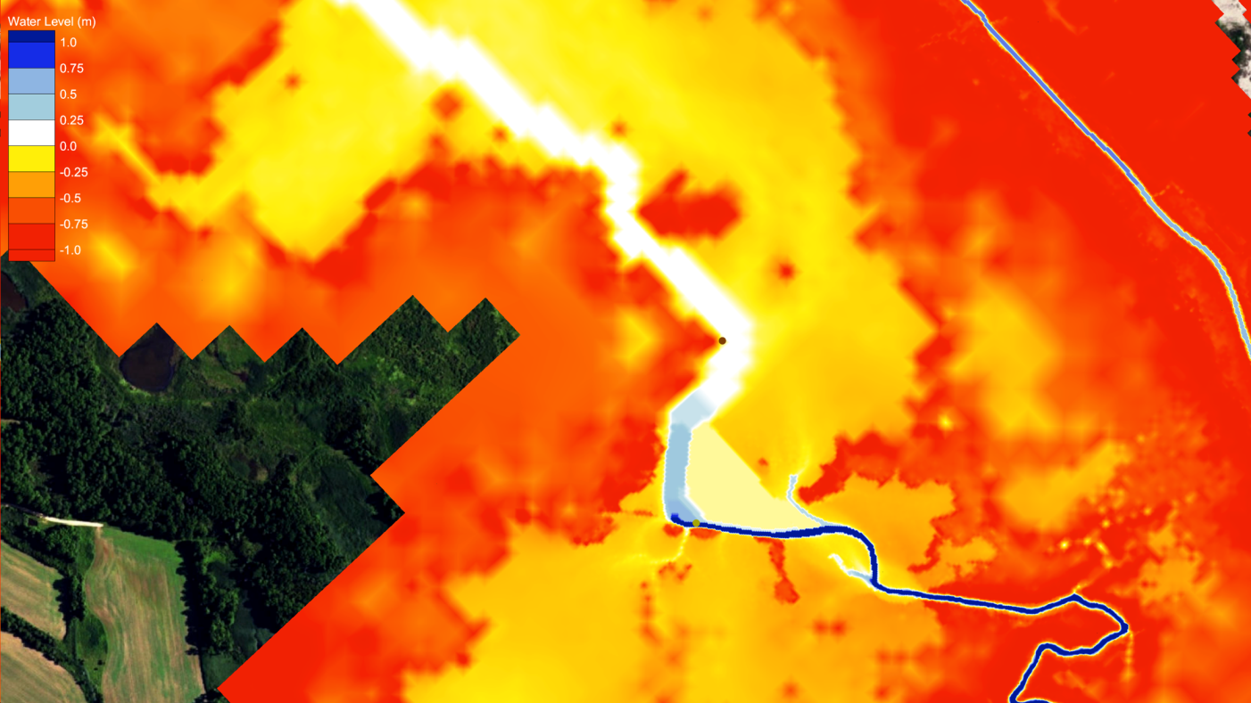
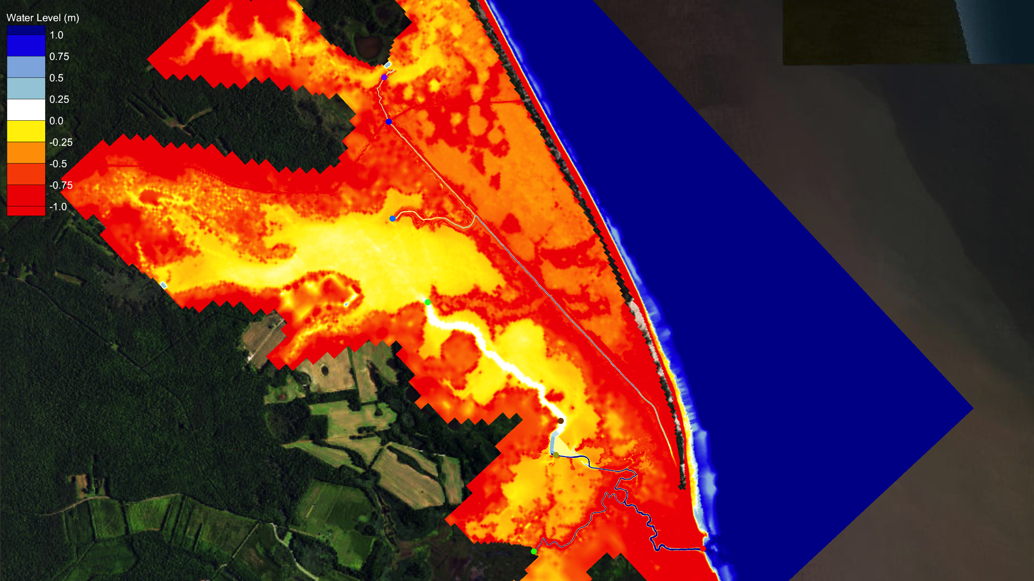
Design Alternative 1
Design Alternative 1 (DA1): Clear out HS3 & boardwalk

Slide 31
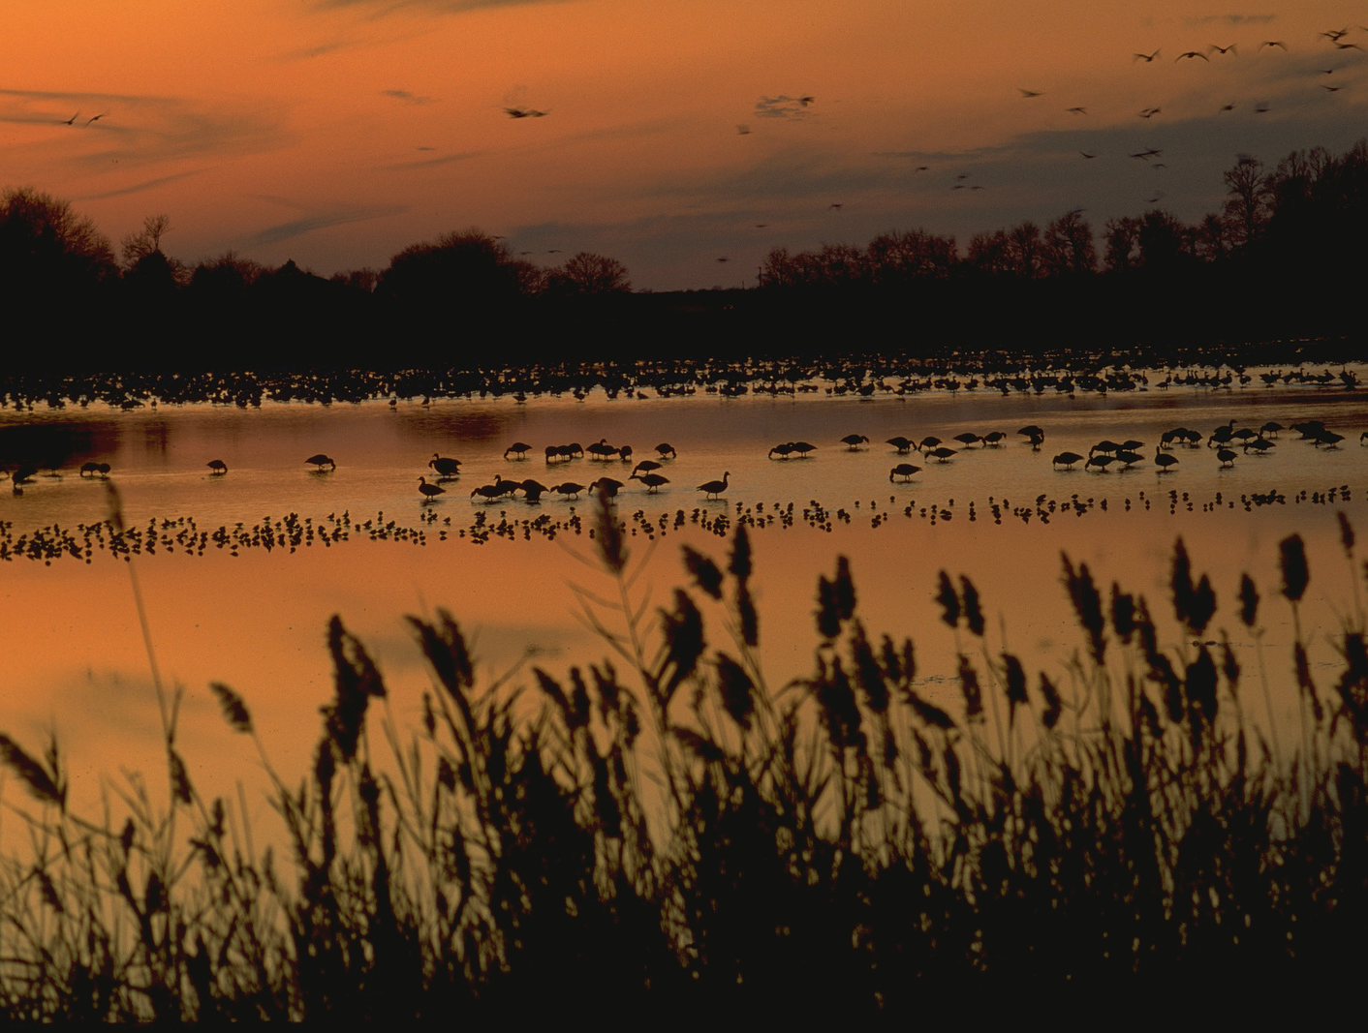

Slide 32
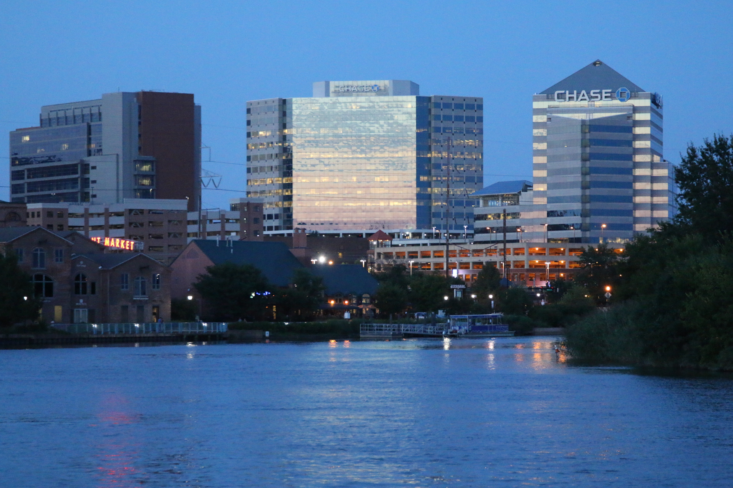
Cities
Urban Conservation
Creating a Greener, Healthier Wilmington

Slide 33
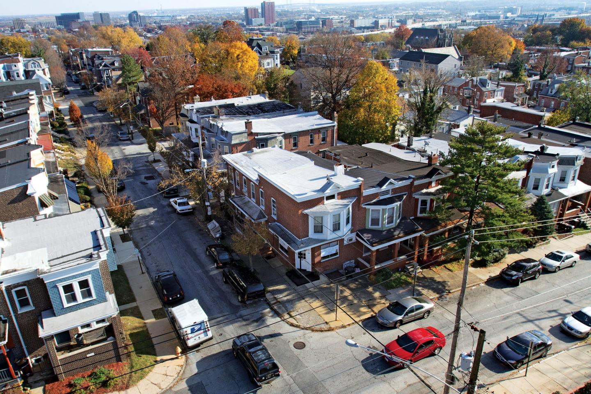

Slide 34
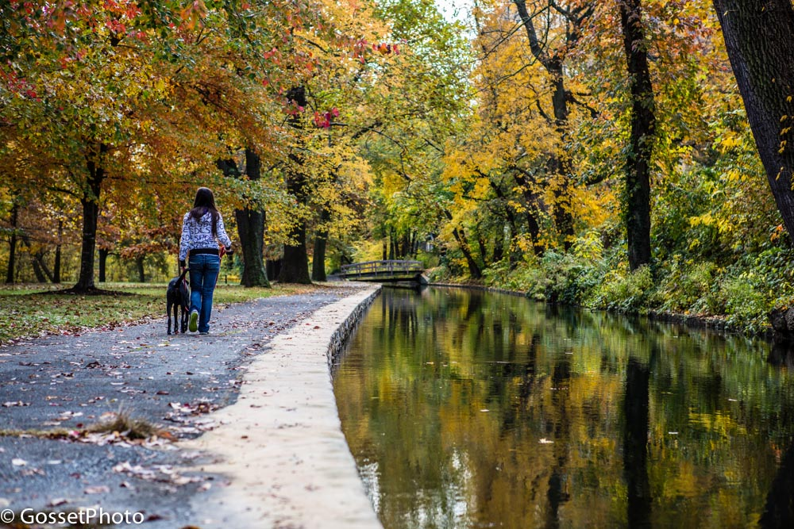

Slide 35
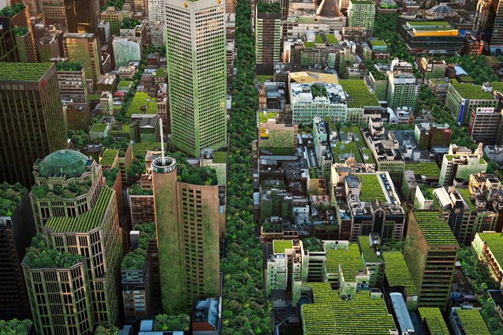
Triple Bottom Line
Economic
Social
Environ-mental

Slide 36
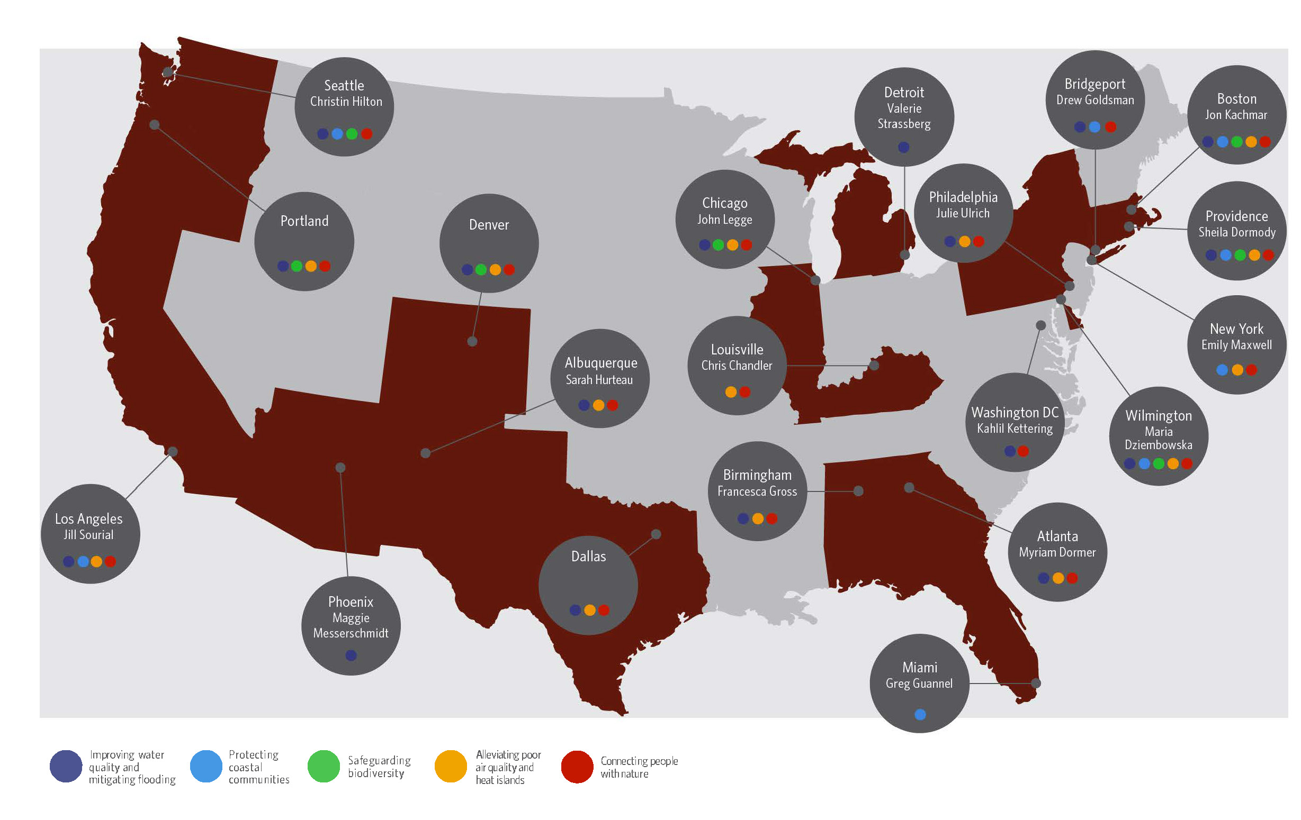
North America Cities Network
Wilmington

Slide 37
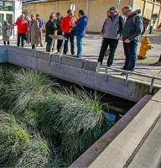
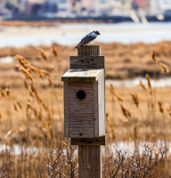



Urban Solutions
Improving water quality and mitigating flooding
^{Alleviating poor} ^{air quality and}
^{heat islands}
^{Protecting coastal} ^{communities}
^{Safeguarding}
^{biodiversity}
^{Connecting people} ^{with nature}

Slide 38





Sustainability Index
QUALITY
OF LIFE
Purpose, Community, Wellbeing
LEADERSHIP
Collaboration, Management, Planning
RESOURCE
ALLOCATION
Materials, Energy, Water
NATURAL
WORLD
Siting, Land and Water, Biodiversity
CLIMATE
AND RISK
Emission, Resilience
Notes:
Quality of Life specifically addresses a projects impact on communities from the health and wellbeing of individuals of the wellbeing of the larger social fabric as a whole.
Leadership is comprised of the tasks that demonstrate effective leadership and commitment by all parties involved in a project. The meaningful commitment from the owner, team leaders, & constructors.
Resource Allocation measures the use of renewable and non-renewable resources for the project. Benefits of managing resources needed will allow a longer life as we know it.
Natural World allows project teams to assesses the effect of the project on the preservation and renewal of ecosystem functions. This section addresses how to understand and minimize negative impacts while considering ways in which the infrastructure can interact with natural systems in a synergistic and positive way.
Climate And Risk looks at two main concepts: minimizing emissions that may contribute to increased short- and long-term risks and ensuring that infrastructure projects are resilient to short-term hazards or altered long-term future conditions.
Note to Speakers: You may want to provide the Credit List handout that shows all 60 credits.

Slide 39

Socio-Ecological Assessment

Slide 40


Comprehensive Vision and Plan

Slide 41


Slide 42












Catalytic Collaboration

Slide 43

Water Funds
Freshwater Security
The Brandywine-Christina Healthy Water Fund

Slide 44

The Water Fund Model
Notes:
Model developed in Latin America where issues simple; applying to East Coast watershed much more complex – Need to balance Urban and Agricultural issues – ensuring long-term viability of farms and food security in 100-mile radius of major metropolitan areas.

Slide 45


Brandywine-Christina Watershed
Notes:
Watershed 565 square miles from Amish dairy and produce farms in North to I95 urbanized corridor in South

Slide 46
Business Strategy
Align and Expand Capital
Water Companies
Municipalities
Foundation/Impact
Strategic Capital Deployment
GIS-Based Targeting
Leveraging Relationships
Quantifying Impact
Long-Term Freshwater Security
Sustainable Funding
Enduring Practices
Profitable Farming
Notes:
1. Funding Side – Start with trickle and build - Launch Fund with Water Producers and Philanthropic Capital to prove model; coordinate with municipalities; layer in other funding (State & corporate); Pay-for-Success Model fits very well as accelerator; 2. Project Delivery Side – Using GIS-based technical analysis (UD) to target focus areas; Leverage Conservation Partner Relationships to develop three-to-five year project pipeline in heavy load zones; expand focus areas in subsequent years; 3. Sustainable Model – reinvest proceeds as capital is repaid; enter into new P-f-S contracts; monitor results and adapt practices; generate funds (philanthropic or otherwise) to maintain practices

Slide 47






Stakeholders & Beneficiaries

Slide 48





Regulatory Partners

Slide 49
Science-Based Capital Deployment

Slide 50





Implementing Conservation Partners

Slide 51



Whole Farm Conservation Plans

Slide 52


Pay-for-Success Structure
Investors
Foundations
NatureVest
Impact Investors
Service Providers
Water Fund
Conservation Partners
Farmers
Payors
Water Companies
Municipalities
Verified Performance Metric
Corporations

Slide 53

INSPIRE
Connecting People and Nature
Developing Future Conservation Leaders

Slide 54




Pipeline of Future Leaders
LEAF
GLOBE
PUBLIC ALLIES

Slide 55


Stream Stewards

